Slide 1
ConseNT MENTAL CAPACITY Power of Attorney

Slide 2
Consent
Consent must be obtained before starting any treatment or physical investigation or before providing personal care for a patient.
GOV.UK

Slide 3
Valid Consent
Voluntary- the person making the decision to either consent or not to consent must not be influenced by pressure from another
Informed – the person must be given information about what the care or treatment involves, including benefits and risks, any reasonable alternative treatments, and consequences if treatment does not go ahead
Capacity – the person must be capable of giving consent
https://www.nhs.uk/conditions/consent-to-treatment

Slide 4
Mental Capacity
The ability to use and understand information to make a decision, and to be able to communicate any decision made
https://www.nhs.uk/conditions/consent-to-treatment/capacity

Slide 5
The Mental Capacity Act 2005
A law designed to protect adults who are unable to make decisions for themselves
Helps individuals to plan for the future when they may become unable to make their own decisions
It offers protection to care workers and others who either have to make decisions on behalf of people who lack mental capacity or who have to provide care that is restrictive
The act enables people to make advance decisions about future medical treatment if they lack capacity to consent
https://www.skillsforcare.org.uk/Documents/Standards-legislation/Mental-Capacity-Act/MentalCapacity-Act-card-pdf

Slide 6
MCA – 5 Principles
Presumption of Capacity
Support to make a decision
Ability to make unwise decisions
Best interest
Least Restrictive
https://www.scie.org.uk/mca/dols/practice/care-home

Slide 7
Capacity Test – 2 stages
Does the individual have an impairment or disturbance of the mind or brain (temporary or permanent)
Does the impairment mean that the person is unable to make the decision at the time it needs to be made

Slide 8
A person is unable to make a decision if they cannot ……
Understand the information about the decision
Retain the information in their mind
Use the information as part of the decision-making process
Communicate their decision
GOV.UK

Slide 9
Capacity to consent
If an adult has the capacity to make a voluntary and informed decision to consent to a particular treatment, their decision must be respected
This is still the case even if refusing treatment would result in their death
If a person does not have the capacity to make a decision about their treatment and they have not appointed a Lasting Power of Attorney (LPA), the healthcare professionals treating them can go ahead and provide treatment if they believe that it is in the person’s best interest
Clinicians must take reasonable steps to discuss the situation with appropriate others before making these decisions (ie religious community, relatives, friends) https://www.nhs.uk/conditions/consent-to-treatment

Slide 10
Best Interest decisions
Although a Statement of Wishes is not legally binding, it does however have some standing because it must be taken into account when someone is deciding what is in your ‘best interest’.
The law states that anyone who makes a decision on your behalf must act in your best interests, and when deciding what is in your best interests the decision-maker must take all statements of a person’s preferences and wishes into consideration as part of a Best Interests assessment.
DoH

Slide 11
Lasting Power of Attorney(LPA)
Under English Law, no one can give consent to the examination or treatment of an adult who lacks the capacity to give consent for themself, unless they have been authorised to do so under a Lasting Power of Attorney or they have the authority to make treatment decisions as a court appointed deputy.
DoH (2009)

Slide 12
Power of Attorney
Putting in place a Power of Attorney can give you peace of mind that someone you trust is in charge of your affairs
www.nhs.uk

Slide 13
POWER OF ATTORNEY
2 Types:
- Enduring Power of Attorney
- Lasting Power of Attorney

Slide 14
Enduring Power of Attorney (EPA)
It is no longer possible to make an EPA, but an EPA made before 2007 remains valid.
An EPA deals only with property and financial affairs, not with personal welfare issues.
GOV.UK

Slide 15
Lasting Power of Attorney (LPA)
– came into force in October 2007

Slide 16
Lasting Power of Attorney (LPA)
A legal document that lets you (the ‘donor’) appoint one or more people (‘attorneys’) to help you make decisions or to make decisions on your behalf
Gives you more control over what happens to you if you have an accident or an illness and cannot make your own decisions (ie you ‘lack mental capacity’)
GOV.UK

Slide 17
Lasting Power of Attorney (LPA): 2 Types
Health and welfare
Property and financial affairs
You can choose to make one type or both

Slide 18
Health and welfare lasting Power of Attorney
Use this LPA to give an attorney the power to make decisions about things like:
Where the person is to live
Whether a care home/nursing home is best for them, which one
Whether the person can continue to live at home with help from social services
Healthcare treatment
Life-sustaining treatment
It can only be used when you are unable to make your own decisions

Slide 19
Who can be your Power of Attorney(POA)
Your attorney needs to be 18 years or over. They can be;
A Sister
A Relative
A Friend
A Professional, eg. a solicitor
You must appoint someone who has the mental capacity to make their own decisions.
Your attorney does not need to live in the UK or be a UK citizen. https://www.gov.uk/power-of-attorney/choose

Slide 20
When choosing an attorney, consider…
How well you know them
If you trust them to make decisions in your best interests
How happy they will be to make decisions for you
https://www.gov.uk/power-of-attorney/choose

Slide 21
Lasting Power of Attorney
You must have the mental capacity to appoint a LPA
You must appoint someone who has the mental capacity to make their own decisions

Slide 22
Making decisions for you
Although Attorneys can make decisions on your behalf, they cannot do as they please. They must always act in your best interests
They must always follow the Mental Capacity Act’s 5 basic principles when working out whether and how to act on your behalf
Attorneys can only make decisions that you have allowed them to make in your LPA. If your LPA is for health and care, they cannot make decisions about your money.

Slide 23
Appointing Attorneys
You can appoint just one attorney, or more than one attorney, to act:
“jointly” – they must always make decisions together
“jointly and severally”- they have to make some decisions together and some individually
www.nhs.uk

Slide 24
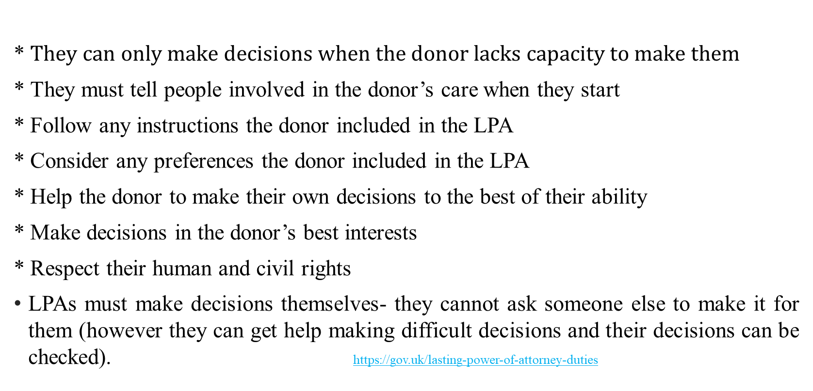
Responsibilities of LPA
* $They can only make decisions when the donor lacks capacity to make them$
* They must tell people involved in the donor’s care when they start
* Follow any instructions the donor included in the LPA
* Consider any preferences the donor included in the LPA
* Help the donor to make their own decisions to the best of their ability
* Make decisions in the donor’s best interests
* Respect their human and civil rights
LPAs must make decisions themselves- they cannot ask someone else to make it for them (however they can get help making difficult decisions and their decisions can be checked). https://gov.uk/lasting-power-of-attorney-duties

Slide 25
GOV.UK Website
Guides on each step:
-How to make an LPA (both online or using paper forms)
-sign into your account
-explains procedure about signing forms
-advises on Witness or Certificate providers
-advises on notifying the relevant people
how to register depending on how you made your LPA
-how to certify a copy of an LPA

Slide 26
GOV.UK Website cont.
-what to do if your Attorney’s details change
-what to do if your Attorney dies
-how to end your LPA

Slide 27
Register an LPA
When you have made your LPA, you need to register it with the Office of Public Guardian (OPG)
It takes 8-10 weeks to register an LPA if there are no mistakes in the application
You can apply to register your LPA yourself if you are able to make your own decisions
Your attorney can also register it for you. You will be told if they do, and you can object to the registration
https://www.gov.uk/power-of-attorney/register

Slide 28
Cost to register an LPA
It costs £82 to register an LPA unless you get a reduction or exemption
To register, both a property and financial affairs LPA and a health and welfare LPA, it is £164
https://www.gov.uk/government/publications/power-of-attorney-fees

Slide 29
If you make a mistake on form
Depending on the type of mistake OPG may let you correct it and apply again within 3 months for £41
https://www.gov.uk/power-of-attorney/register

Slide 30
You can change your LPA
You can ask the OPG to change your lasting LPA if it has been registered and you still have mental capacity to make decisions
https://www.gov.uk/power-of-attorney/change-yourlasting-power-of-attorney

Slide 31
OPG – Contact Details
Office of the Public Guardian
PO BOX 16185
Birmingham
B2 2WH
Telephone: 0300 456 0300
Monday, Tuesday, Thursday and Friday 09.30am to 5pm
Wednesday 10.00am to 5pm
Source: the GOV.UK website https://www.gov.uk/power-of-attorney

Slide 32
Sources:
GOV.UK https://www.gov.uk/power-of-attorney
https://www.gov.uk/power-of-attorney/register
https://gov.uk/lasting-power-of-attorney-duties
https://www.gov.uk/power-of-attorney/choose
https://www.gov.uk/government/publications/power-of-attorney-fees
https://www.nhs.uk/conditions/consent-to-treatment
https://gov.uk/power-of-attorney/change-your-power-of-attorney
GOV.UK: ‘The Green Book’ chapter 2 pg 7 In assets.publishing.service.gov.uk
‘what is capacity’ https://www.nhs.uk/conditions/consent-to-treatment/capacity
‘Skills for Care Pocket guide’ https://www.skillsforcare.org.uk/Documents/Standards-legislation/Mental-Capacity-Act/MentalCapacity-Act-card-pdf
‘The use of DoLS in Care And Nursing Homes’ https://www.scie.org.uk/mca/dols/practice/care-home
‘Giving someone Power of Attorney’ https://www.nhs.uk
DoH (2009): Reference Guide to consent for examination and treatment. 2nd ed: www.dh.gov.uk/publications
https://www.nhs.uk/conditions/social-care-and-support-guide/making-decisions-for-someone-else

