Slide 1
Fostering Effective Partnerships for Change
Conference of Religious – May 2019

Slide 2
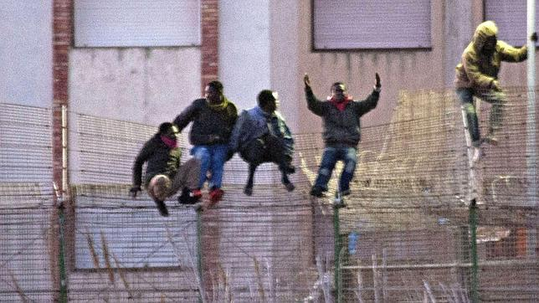
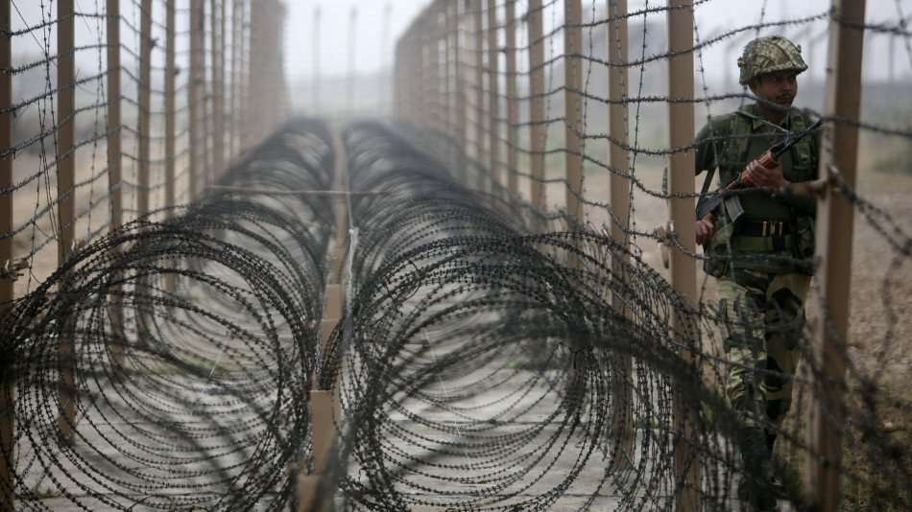
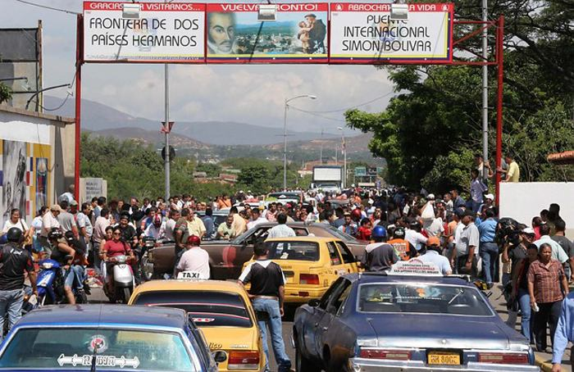
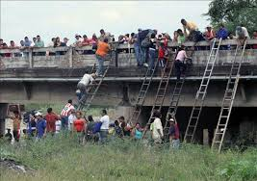
WHILE
SOME ARE BUSY BUILDING
WALLS

Slide 3
WE ARE CALLED TO BUILD
BRIDGES
OF
COLLABORATION
through
PARTNERSHIPS
and
NETWORKING

Slide 4
Pope Francis says to us: Let us work together to ensure that children continue to smile: their faces serene, filled with joy and hope. I also hope for a growth in communion between the members of different Institutes. Might this Year be an occasion for us to step out more courageously from the confines of our respective Institutes and to work together, at the local and global levels. This would make for a more effective prophetic witness. No one contributes to the future in isolation, by his or her efforts alone, but by seeing himself or herself as part of a true communion which is constantly open to encounter, dialogue, attentive listening and mutual assistance. Consecrated men and women are also called to true synergy with all other vocations in the Church, beginning with priests and the lay faithful……………and even beyond its boundaries”.

Slide 5
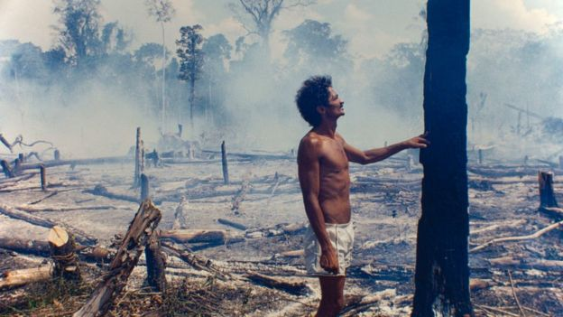
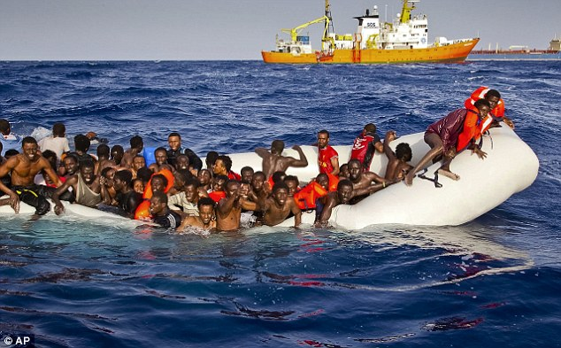
Climate & Environment
Migrants & Refugees

Slide 6
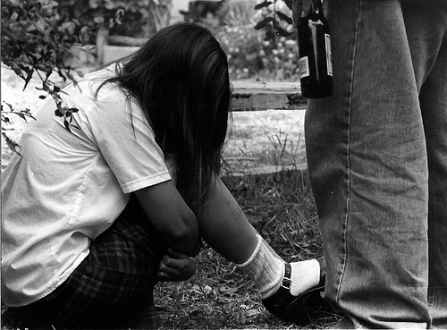
Human Trafficking Social Inclusion

Slide 7
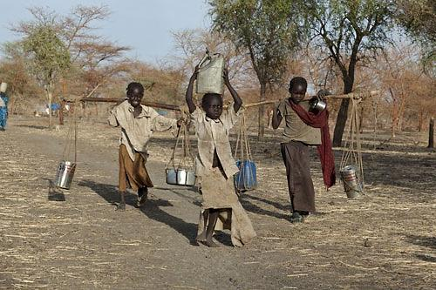
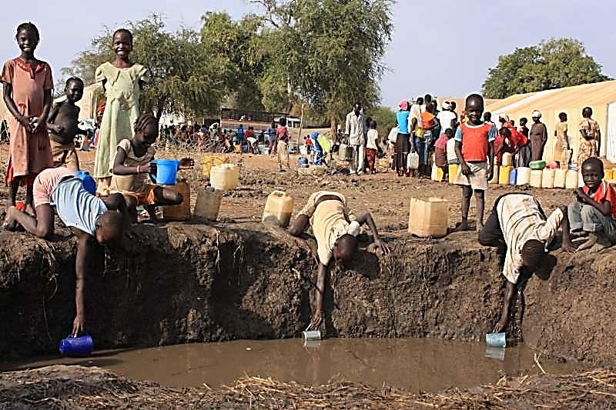
Basic Human Needs
HOUSING

Slide 8
Internal Matters:
Care of the Elderly
Practical Matters
-visas
-data base
Formation
Sharing Resources
Professional
Property
Personnel
Leadership Governance
Trusts
PRAYER
and Intercession
Contemplative
Listening

Slide 9
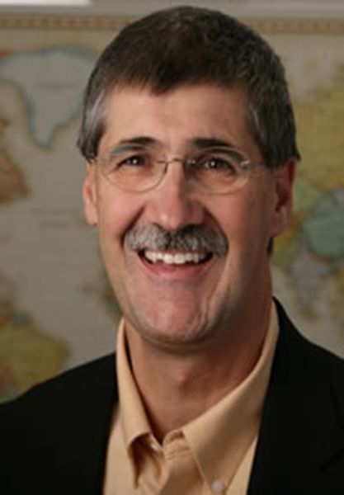
CROSS SECTORAL COLLABORATION Learning from Another Discipline
Concepts:
1. Moral Imagination
2. Web watching and weaving
3. Yeast
4. Platforms
John Paul Lederach – a Mennonite

Slide 10
MORAL IMAGINATION
is the capacity …..to recognize turning points and possibilities …..to imagine constructive processes …..to give birth to what does not yet exist
“Moral Imagination….The Art and Soul of Peace Building”

Slide 11
Turning Points
Certain moments that can point people in a new direction
Moments that are pregnant with new life which often rise from what seems barren ground

Slide 12
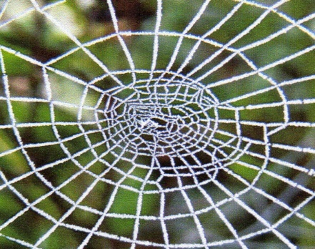
WEB WATCHING
Understand the social-political-economic geography
Think about intersections
Be smart flexible

Slide 13
1. WEB WEAVING for us as religious……is working to locate strategic anchor points and intersections in society 1. Other congregations 2. Church bodies – parish group 3. Leaders in civil society 4. Faith based organizations 5. Conferences of Religious 6. Donors 7. Local NGOs & INGOs 8. Government agencies 9. Others The Art of Web-Weaving careful observation know-how locate strategic anchor points intersections

Slide 14
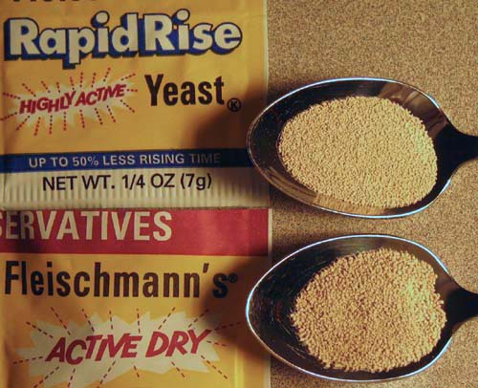
The Yeast …….the catalyst for change is ……..a small group of the right people involved in the right place at the right time ….they create a pull in an organization or in a society As religious we can be the yeast ……….

Slide 15
A Transformative Platform Yeast = small strategic group Platform - Imaginative mediative capacity
creating multiple webs

Slide 16
Key Change Words and Phrases
TURNING POINTS
WEBS
YEAST
PLATFORMS
MULTIPLE
FLEXIBLE

Slide 17
Elements of the Change Process
1.
Small committed group
3.
4.
Builds a network or multiple networks to support the initiativenetworks
2.
Creates a platform with others – organizations or individuals
Works in a smart flexible way which requires ongoing change which requires i

Slide 18
Collaboration and Networking
LOCAL
With other Congregations
NATIONAL
With Christian groups
INTERNATIONAL
With persons of
REGIONAL
With faith groups
good will
With civil society

Slide 19
SOME EXAMPLES from UISG: NEVER DO ALONE WHAT WE CAN DO TOGETHER
CLIMATE
Environment
Local Congregations of Sisters committing to action
Networking 600 + catholic groups to respond to Laudato Si
ANTI- TRAFFICKING
Country networks: formed by individual sisters
MIGRANTS & REFUGESS
UISG International Desk linking individual sisters
Migrants and refugees section (Vatican)
Caritas Network - local and international : World Vision (Regional Office)
Academy of Science (Vatican) and Dicastery for Integral Human Development
Joined the Catholic Global Climate Movement
Talitha Kum – Sisters and collaborators worldwide network (UISG)
Jesuit Refugee Services (Regional and International)
House for migrant women and children (Rome)

Slide 20
SOME EXAMPLES from UISG
WAR &
CONFLICT
Sisters and others accompanying victims of trauma (DRC)
Being supported by the UK Government
??????
TODAY”S NEEDS ARE COMPLEX AND LAYERED
??????
With whom COULD YOU NETWORK AND PARTNER?
Being trained by psychotherapists and forming a network
LEADS TO TRANSFORMATION
IS A PROPHETIC SIGN FOR TODAY”S WORLD
CROSS SECTORAL COLLABORATION IS MORE EFFECTIVE
WHAT COULD YOU NETWORK AND PARTNER ABOUT- in relation to religious life? In relation to local, national and global needs?

