Slide 1
Types of dementia
8th March 2022

Slide 2
Dementia - statistics
Research shows there are more than 850,000 people in the UK who have dementia.
One in 14 people are over the age of 65
One in 6 people over the age of 80.
It is estimated that by 2025, the number of people with dementia in the UK will be more than 1 million.

Slide 3
What is dementia
Dementia is the broad term used to describe a group of related symptoms associated with an ongoing decline of brain functioning.
There are over 200 types of dementia.
Each type of dementia stops a person’s brain cells (neurones) working properly in specific areas.
Some symptoms are more likely to occur with certain types of dementia.

Slide 4
Memory problems
increasing forgetfulness
difficulty retaining new information
getting lost in places that used to be familiar
struggling with names
misplacing things frequently

Slide 5
Cognitive Ability
difficulty concentrating
difficulty understanding time and place, eg getting up in the middle of the night to go
to work, even if retired.
difficulty with choosing what to buy and paying for shopping
struggling with decision-making and reasoning
loss of interest in activities they used to enjoy
restlessness
reluctance or lack of motivation to partake in previously enjoyed activities

Slide 6
Communication
struggling to find the right words
repeating themselves often
difficulty making and following conversation
difficulty reading and writing
becoming quieter and more withdrawn
loss of interest in socialising
loss of confidence
changes in personality and behaviour
mood swings, anxiety and depression

Slide 7
Symptoms and presentation
Although dementia has a common set of symptoms, each type presents itself differently, and people may have some, or all, of the symptoms.
It is important to remember that everyone has their own experience of dementia, and the symptoms may vary between people.

Slide 8
4 Most common types of Dementia
Alzheimer’s disease
Vascular dementia
Frontotemporal dementia
Dementia with Lewy bodies
Common Feature -
abnormal proteins
in the brain.

Slide 9
Alzheimer’s Disease
This is the most common type of dementia – around 60% of diagnoses in the UK
Proteins build up and form abnormal structures called ‘plaques’ and ‘tangles’. Eventually nerve cells die and brain tissue is lost.

Slide 10
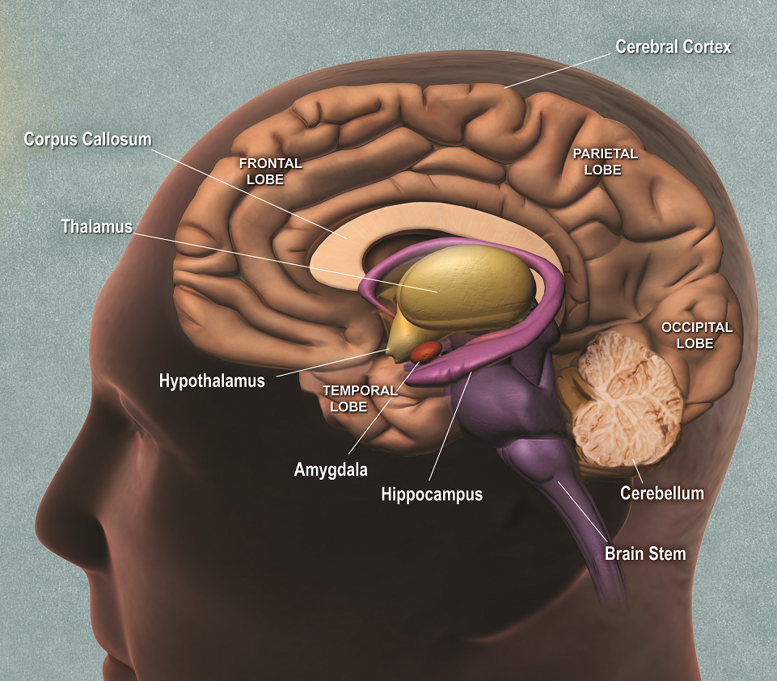

Slide 11
Vascular dementia
The second most common type of dementia.
Around 17% of people diagnosed with dementia will have vascular dementia.
Vascular dementia is an umbrella term for a group of conditions caused by problems with blood circulation to the brain.
It is caused by small blood clots (Transient Ischaemic Attacks or TIAs) preventing oxygen reaching the brain tissue.
Damage to the blood supply can also be caused by blocked arteries (atherosclerosis) or bursting of blood vessels in the brain (haemorrhage).

Slide 12
Vascular dementia- signs & symptoms
The signs and symptoms of vascular dementia depend on which area of the brain has been affected.
Memory problems may not be an issue initially, if this area of the brain has not been damaged, although they may occur later.

Slide 13
Managing effects of Vascular dementia
Drugs that are routinely prescribed for Alzheimer’s disease do not have benefits for vascular dementia and are not recommended for it.
If vascular dementia is caused by or related to heart disease, diabetes, or strokes, changing lifestyle and taking medication to control these conditions may prevent dementia from getting worse.
Consider diet, activity, smoking cessation and alcohol consumption.

Slide 14
Mixed dementia
It is possible to have not just one, but two or even three, types of dementia.
A person with mixed dementia would experience a mixture of the symptoms associated with the types of dementia they have.
Mixed dementia is much more common in older age groups, such as those over 75 years.
The most common is a combination of Alzheimer’s disease and vascular dementia.

Slide 15
Mixed dementia (Alzheimer’s and Vascular dementia)
Main risk factors - older age, high blood pressure and blood vessel damage in the brain.
Research indicates that mixed dementia is often not recognised and diagnosed effectively, with the person diagnosed as having only one type of dementia.
This can lead to a person missing out on interventions that could be helpful for the unrecognised condition.
The symptoms of mixed dementia can vary depending on the part of the brain affected.
If the person has two types of dementia the symptoms can be more noticeable and appear to progress more rapidly.

Slide 16
Frontotemporal Dementia
Around 12% under the age of 65
Most commonly occurs between ages of 45-65 years
Less common over age of 65 years

Slide 17
What causes frontotemporal dementia
Frontotemporal dementia is a group of conditions caused by the death of nerve cells and pathways in the frontal and temporal lobes of the brain. The damage to the brain is linked to abnormally forming proteins that interfere with communication between brain cells.

Slide 18
Frontotemporal dementia
This is a progressive condition which affects behaviour and personality, which sometimes leads to disinhibition and inappropriate social behaviour,
Eating patterns can also be affected with people suddenly bingeing on food, especially sweet foods.
This form of Dementia can sometimes be confused with depression, stress, anxiety, psychosis or obsessive compulsive disorder

Slide 19
Lewy body dementia
Lewy body dementia is a progressive, challenging condition, which is thought to be the cause
for 10-15% of people with dementia.
Lewy body dementia is caused by abnormal clumps of protein (called Lewy bodies) gathering inside brain cells. These Lewy bodies can build up in many parts of the brain but particularly in the areas responsible for thought, movement, visual perception and those regulating sleep and alertness.
Lewy bodies are present in people who have Parkinson’s disease, usually in the areas of the brain responsible for movement. Not everyone with Parkinson’s will develop dementia, but the risk increases the longer a person lives with the condition.

Slide 20
Lewy Body dementia (LBD)
An umbrella term for two different types of dementia:
Dementia with Lewy bodies(DLB)
Parkinson’s disease dementia (PDD)

Slide 21
Differences between DLB and PDD
Dementia with Lewy bodies
Parkinson’s disease dementia
Cognitive changes happen first, or at the same time as physical changes ie changes in thinking, difficulties with visual perception, memory loss, sleep problems. These symptoms tend to occur at least one year before, or at the same time as, problems with movement.
Physical changes happen first. This includes difficulties with movement (Parkinsonism), such as tremor, rigidity or slowness. These symptoms are experienced first; at least one year or more before cognitive changes.

Slide 22
Symptoms of Lewy body dementia
Swallowing problems
Apathy
Anxiety
Depression
Delusions
Dizziness on standing up
Impaired sense of smell
Increased salivation or drooling
Excessive sweating
Problems with speech
Difficulty with remembering events or names of familiar people
Recurring visual hallucinations
Disturbed sleep
Sudden changes and fluctuations in alertness
Slowed movement, difficulty walking, shuffling or appearing rigid
Tremors
Problems with balance and falls
Bladder and bowel problems

Slide 23
Treatments for Lewy body dementia
Some of the medicines used to treat Alzheimer’s disease can help with cognitive symptoms of LBD and can help reduce distressing hallucinations, concentration and memory problems – usually most effective in the early or moderate phases, but do not help everyone.
Medicines used for Parkinson’s may also be helpful – but there is also the risk that certain medicines may make hallucinations worse.
Many people with LBD are particularly sensitive to antipsychotics used to treat hallucinations. Only certain atypical antipsychotics should be used with caution.

Slide 24
Get checked in time!
We looked at various symptoms of dementia. However, these symptoms can be caused by other conditions such as infections, delirium, diabetes, underactive thyroid, depression, anxiety, vitamin deficiency etc. These conditions are treatable, so it is important to visit the GP for tests to identify and manage these conditions.
Once these conditions have been ruled out, an early diagnoses of dementia can help a person and Community to understand the type of dementia and associated behaviours, and what can be done to support them.

Slide 25
Tests to expect
Initial visit to GP
Discuss problems identified, when they started, how they are affecting daily life etc
GP will test cognitive abilities by asking various questions eg day, date and year; name some common objects, remember and repeat items to test concentration and short-term memory; complete a drawing etc
A physical examination including blood tests to rule out other possible causes
GP may refer to a specialist such as psychiatrist with experience in dementia, a geriatrician, a neurologist
Referral to memory clinic
Specialist will assess cognitive abilities using tests of attention, memory, verbal fluency and language, and their visual and spatial abilities
A brain scan to look for abnormalities.

Slide 26
Dementia Prevention
Although getting older is undeniably the biggest risk factor for dementia, research suggests that up to one in three cases of dementia are preventable.
Have regular health checks. Have blood pressure, cholesterol, weight checked.
Ensure any long term conditions eg diabetes or thyroid conditions are well controlled.
Ensure any medication is taken as prescribed.
Maintain a healthy diet.

Slide 27
Dementia Prevention
Low alcohol intake – at most, aim for no more than 14 units a week
Avoid smoking
Take regular exercise
Keep socially active – partake in group situations as well as one to one
Taking part in hobbies like art, woodwork, learning a new language, knitting, puzzles and listening to music – these will stimulate different areas of the brain and help with attention and concentration.

Slide 28
Resources
https://www.dementiauk.org
https://www.nhs.uk/conditions/vascular-dementia
https://www.bing.com/images (photo)
https://www.momjunction.com (photo)

