Slide 1
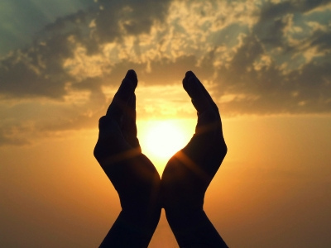
Embracing the Future with Hope

Slide 2
Hope is definitely not the same thing as optimism. It is not the conviction that something will turn out well, but certainty that something makes sense regardless of how it turns out.
Vaclav Havel

Slide 3
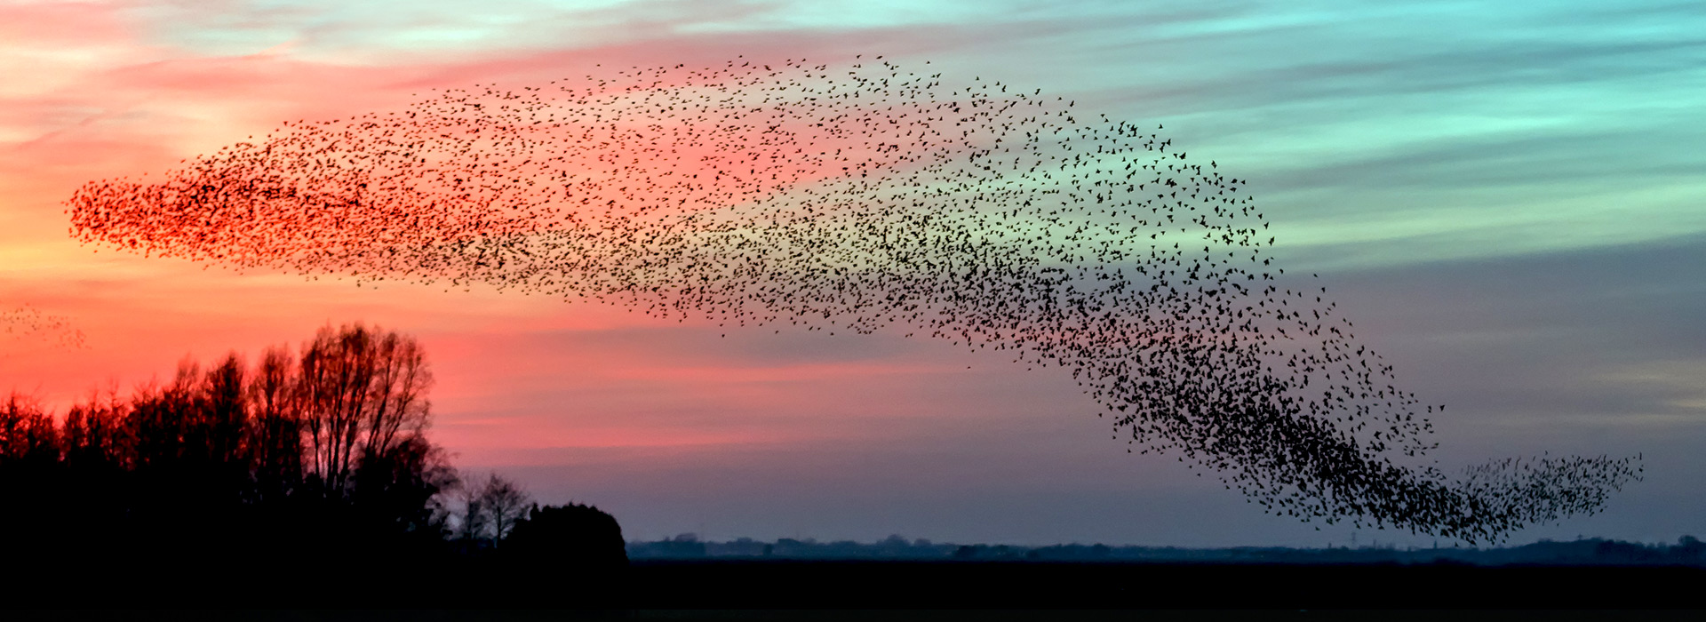
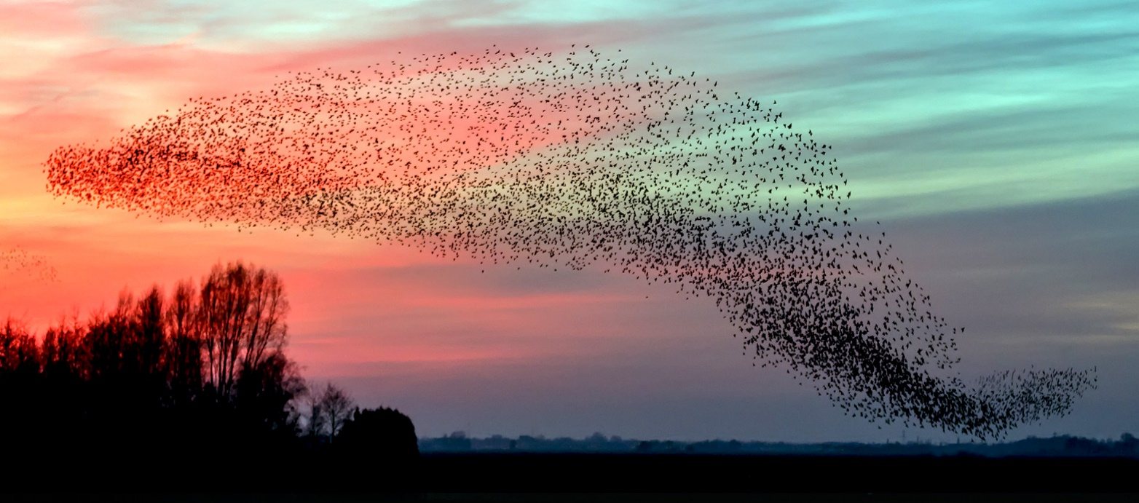
Hope sees the invisible, feels the intangible, and achieves the impossible. Helen Keller

Slide 5
Though the fig tree does not blossom, and no fruit is on the vines; though the produce of the olive fails and the fields yield no food; though the flock is cut off from the fold and there is no herd in the stalls, yet I will rejoice in the Lord; I will exult in the God of my salvation. God, the Lord, is my strength; he makes my feet like the feet of a deer, and makes me tread upon the heights.
(Habbakuk 3:17-19)

Slide 6
Hope is bold; it can look beyond personal convenience, the petty securities and compensations which limit our horizon, and it can open us up to grand ideals that make life more beautiful and worthwhile…
Let us continue then to advance along the paths of hope.
(Pope Francis, Fratelli Tutti, 2020.)

Slide 8
.
The Inner Journey-Placing our hope in God alone.

Slide 9
We find it difficult to unplug and watch the breath of our own being-in-stillness. Ilia Delio osf

Slide 10
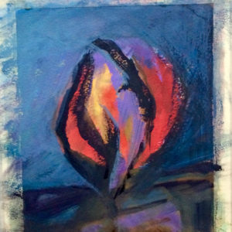
God, Presence, Compassion,
Love or simply Being

Slide 11
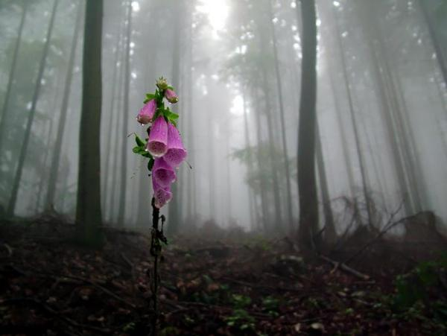
We are encumbered by old assumptions, burdened by memories that limit our horizons and therefore, unfree to see God coming to us from the future.” Constance Fitzgerald odc
“

Slide 12
The human heart can go the lengths of God…
Thank God our time is now when wrong
Comes up to face us everywhere,
Never to leave us till we take
The longest stride of soul man ever took.
Affairs are now soul size.
The enterprise is exploration into God.
Christopher Fry, The Sleep of Prisoners

Slide 13
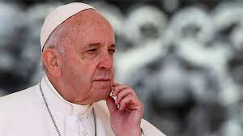
Discernment
He therefore listens to consolations and desolations, tries to understand where they lead him and makes his decisions in accordance with this spiritual process. (Antonio Spadaro sj, La Civilità Cattolica Sept. 2020)

Slide 14
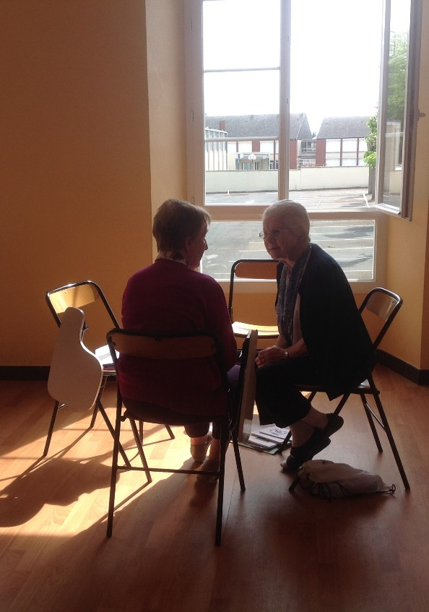
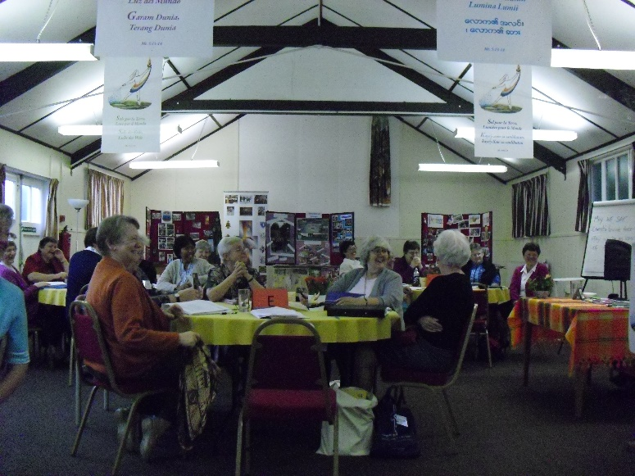
Listening to one another and discerning together is key to embracing the future with hope.

Slide 15
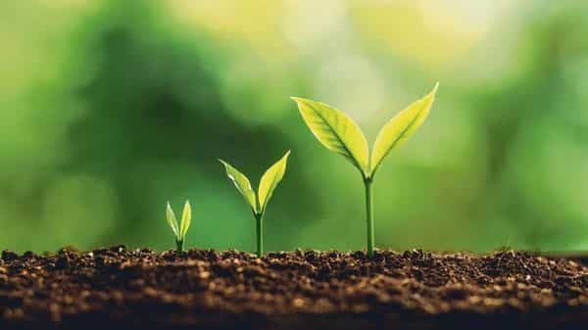
3 Hopeful Movements in Religious life today
Cosmology/ Ecology
Creativity
Intercultural Living

Slide 16
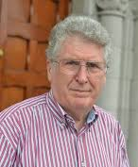
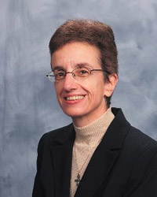
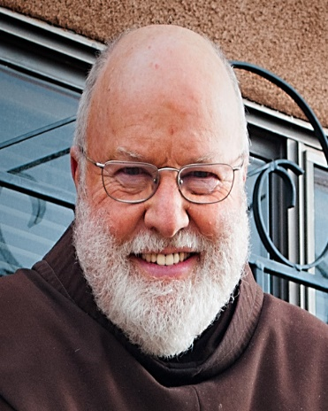
Embracing
Hope
Cosmology Ecology

Slide 17
Embracing Hope
Creativity
Collaboration
TRAC
Working to end sex Trafficking

Slide 18
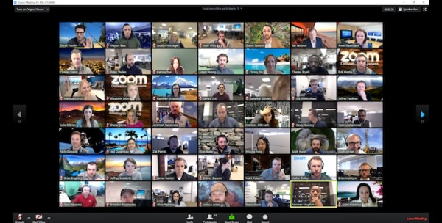
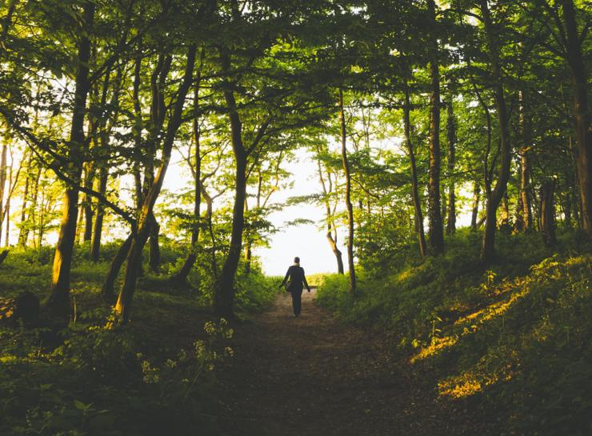
Creativity
Information Technology
Embracing Hope
Online EVENT Fratelli Tutti
Every Friday, Oct 9-Nov 20 Reading Group
FCJ Centre St, Hugh's
ONLINE INDIVIDUALLY GUIDED RETREATS
AT ST BEUNO'S

Slide 19
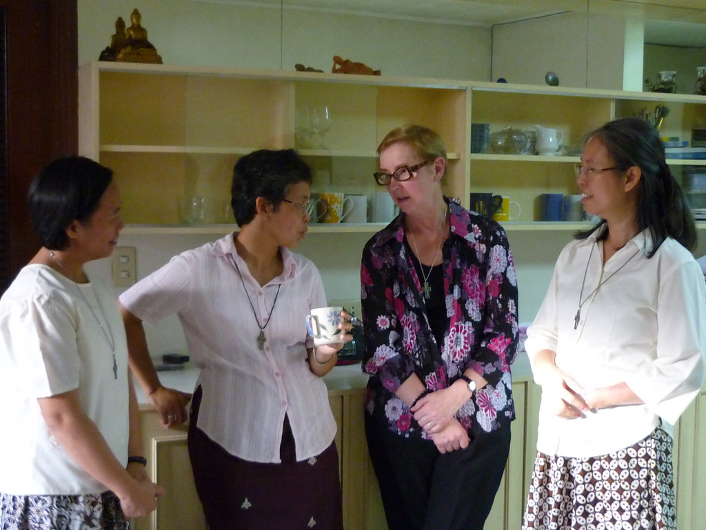
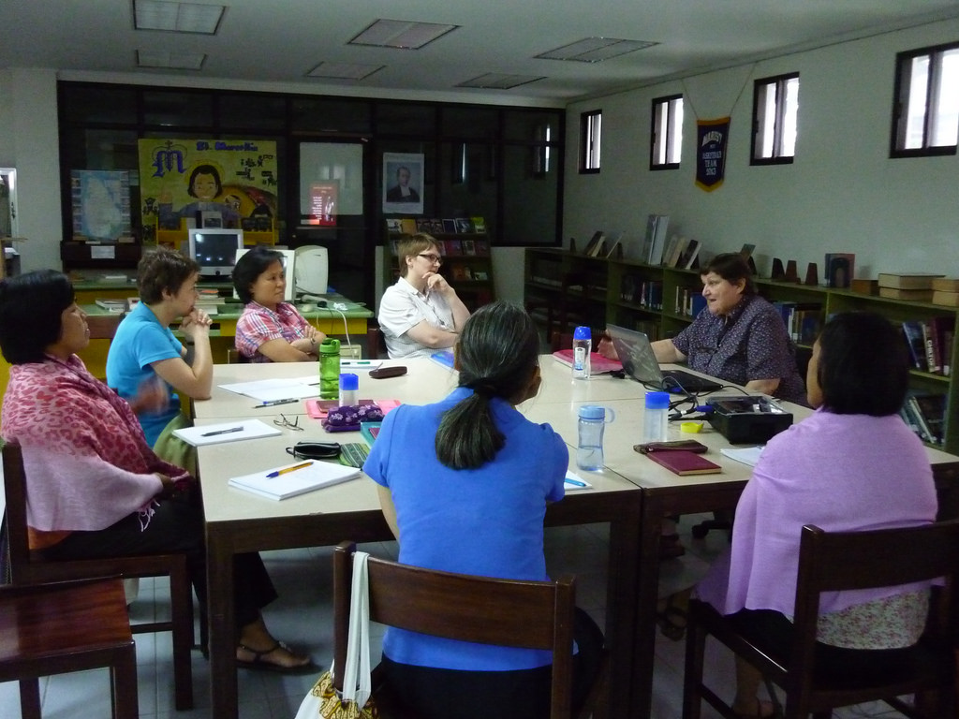
Embracing Hope
Intercultural Living

Slide 20
Iceberg
of
Culture
Emotions

Slide 21
Pilgrim

Slide 22
Songbird

Slide 23
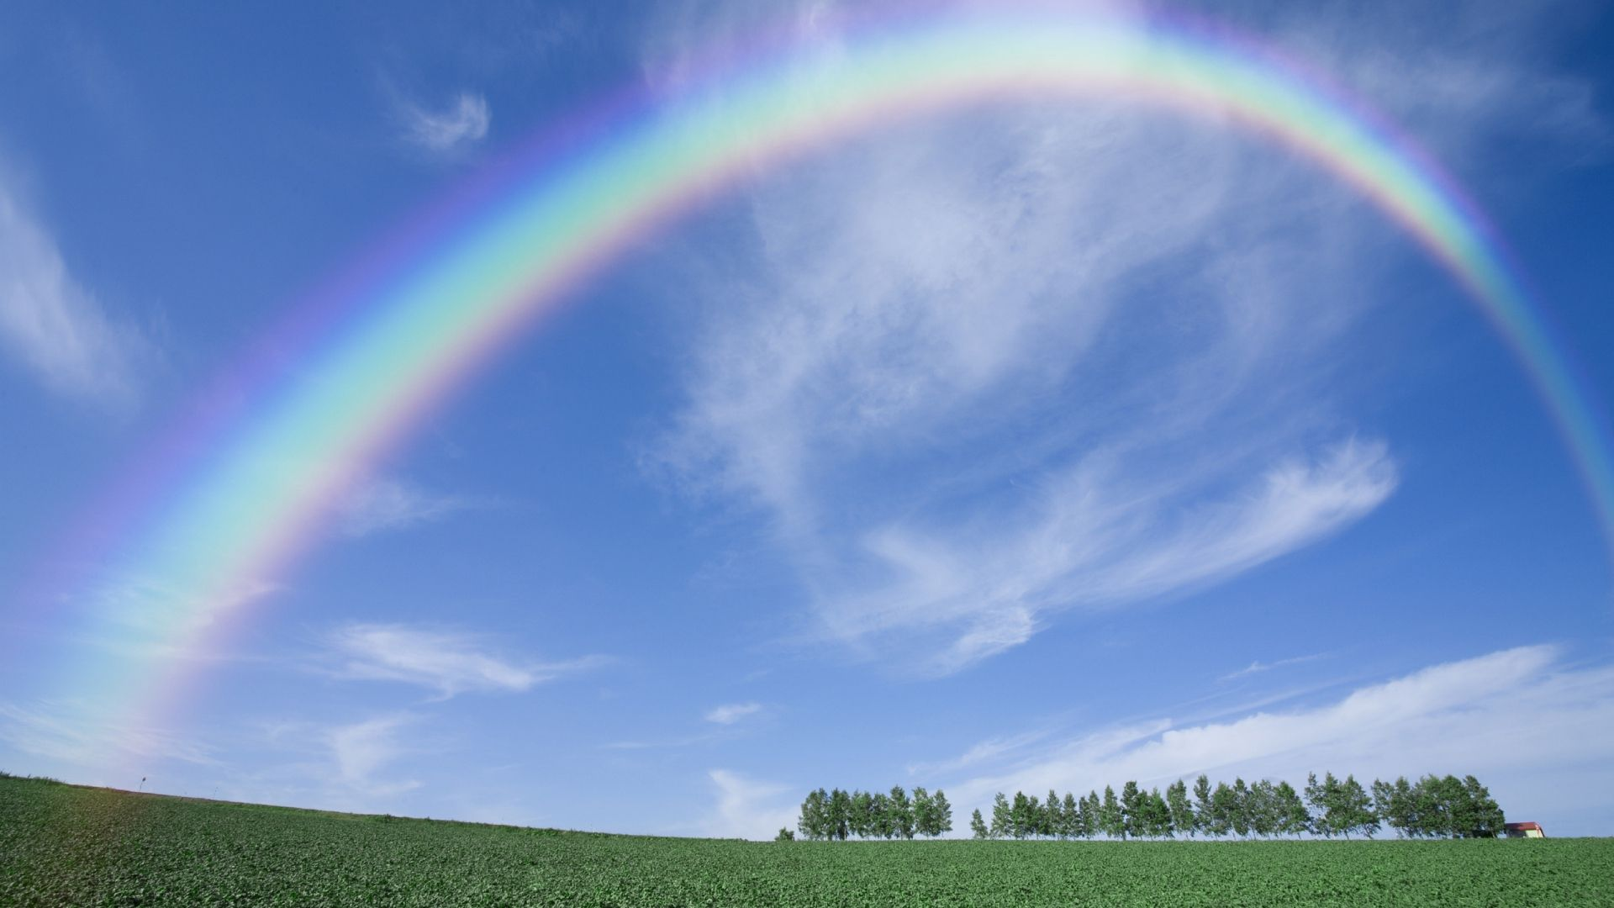
Religious, pilgrims, songbirds are constantly setting out on a journey, embracing the future with hope in our provident God!

