Slide 1
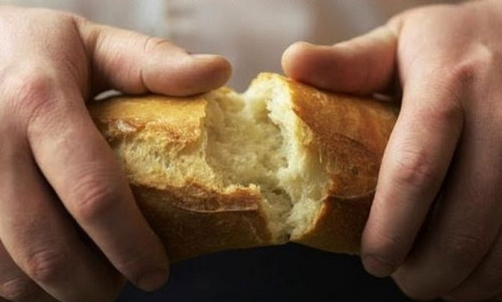
The NARRATIVE
of COMMUNION

Slide 2
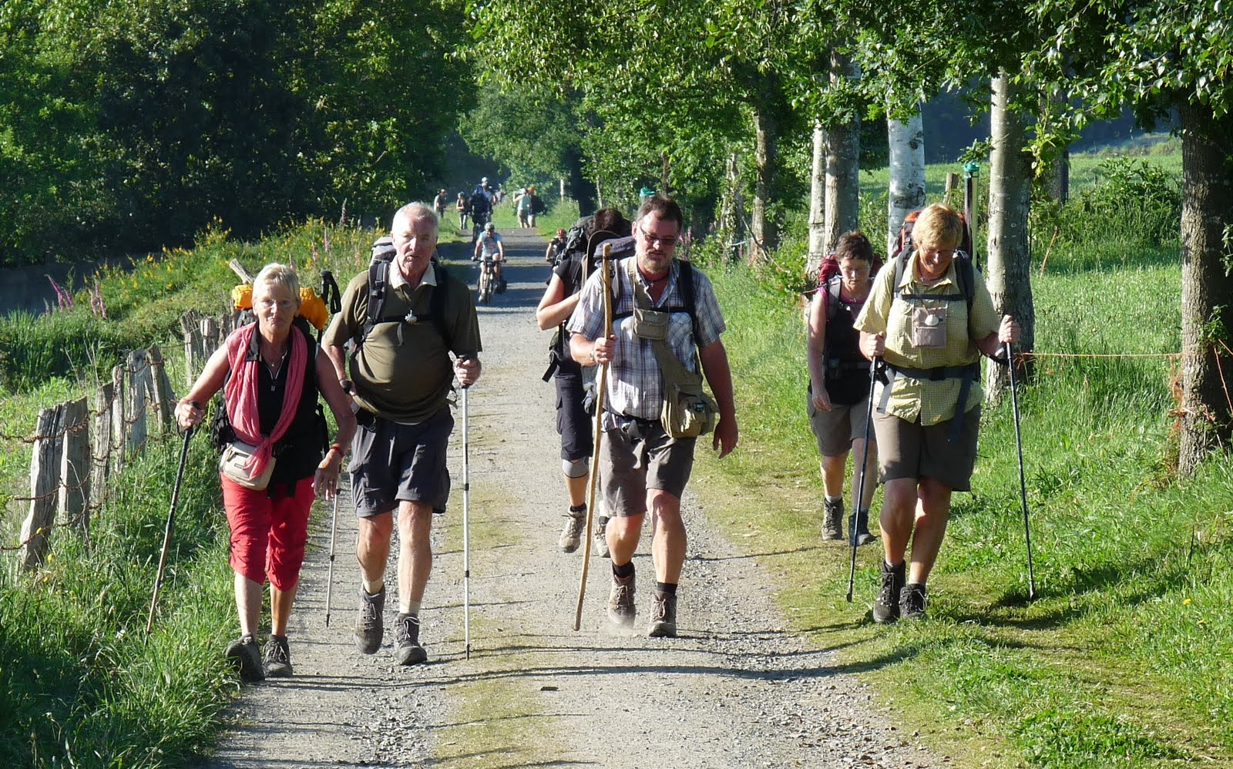
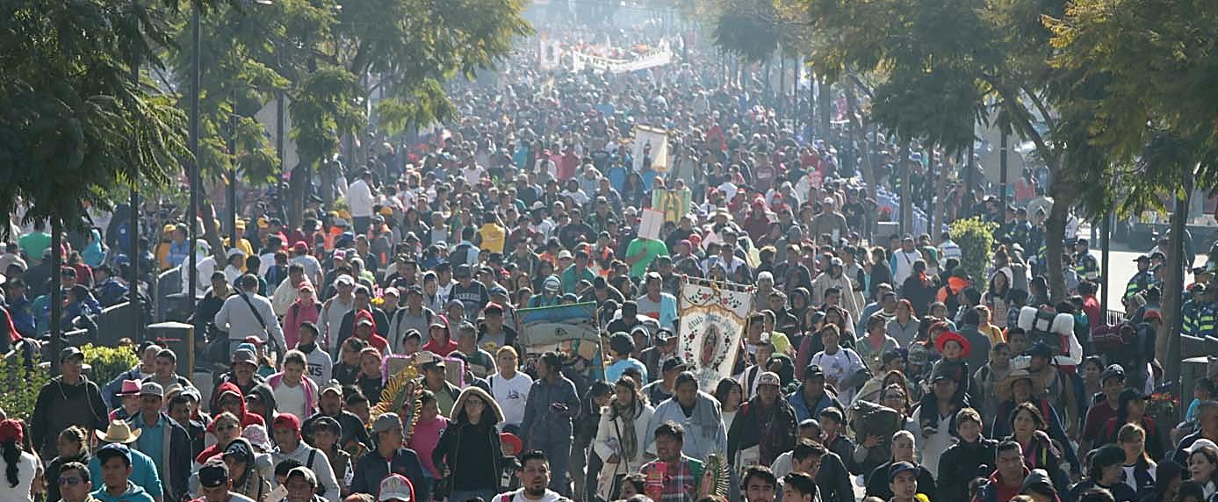
People of God
to walk together

Slide 3
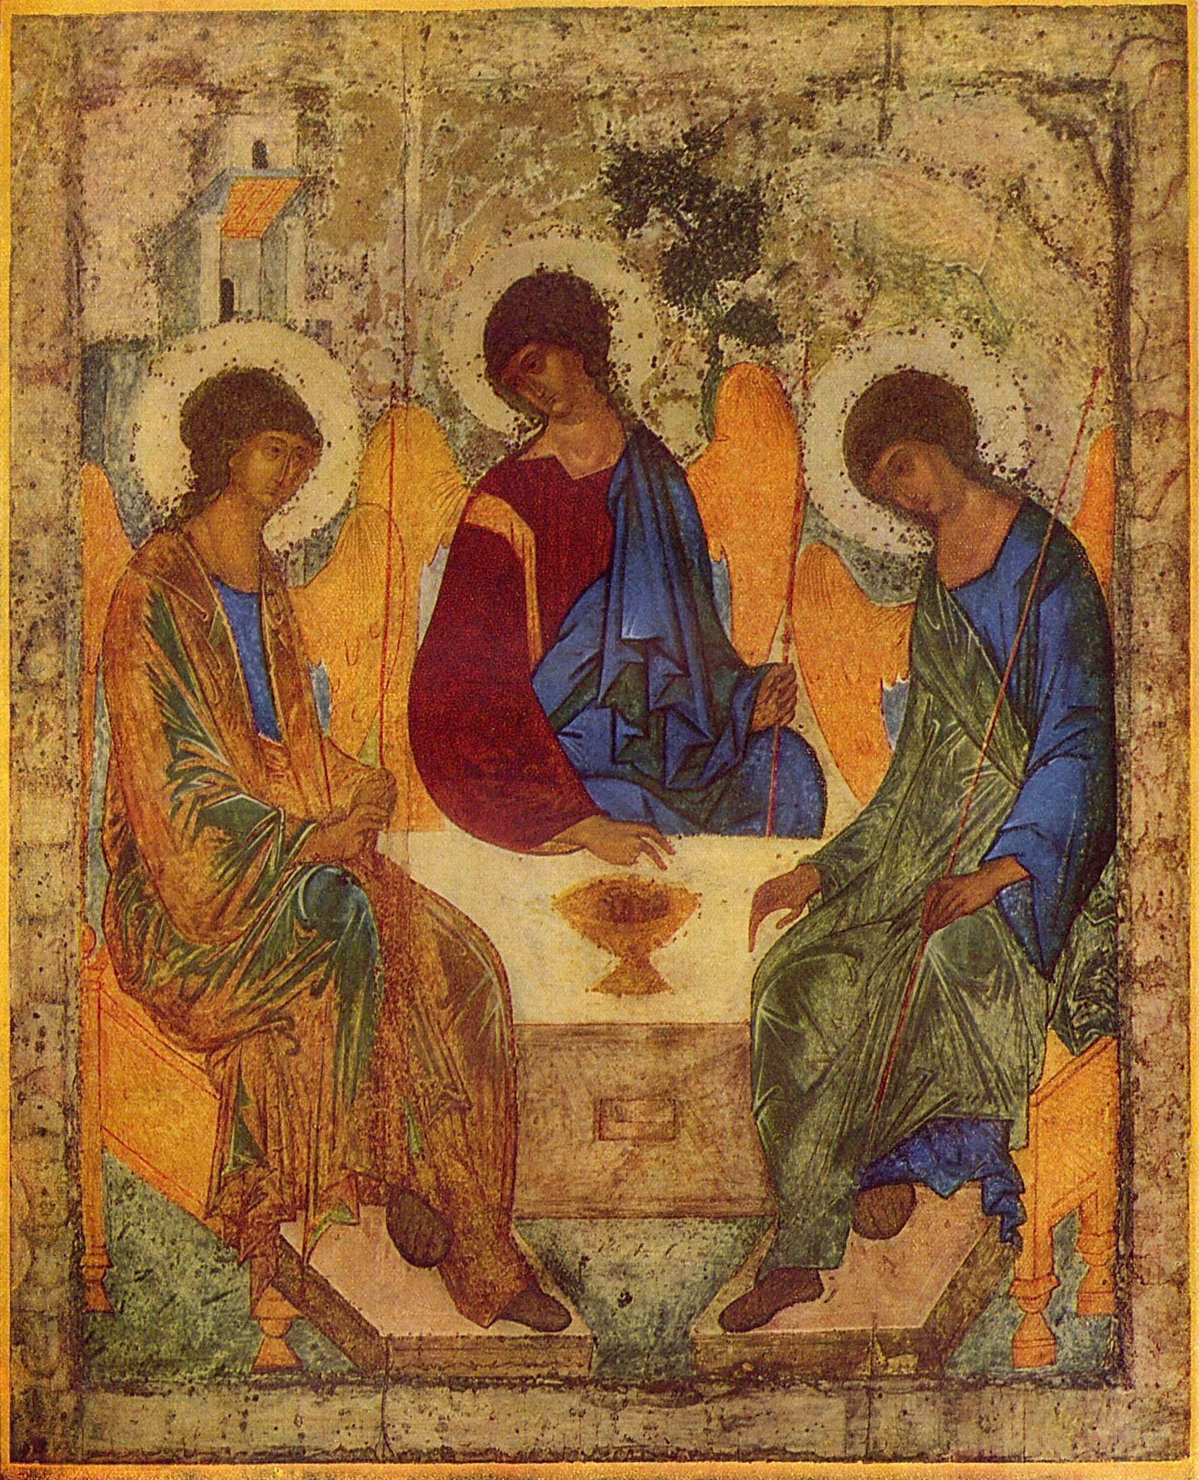
The Trinity

Slide 4
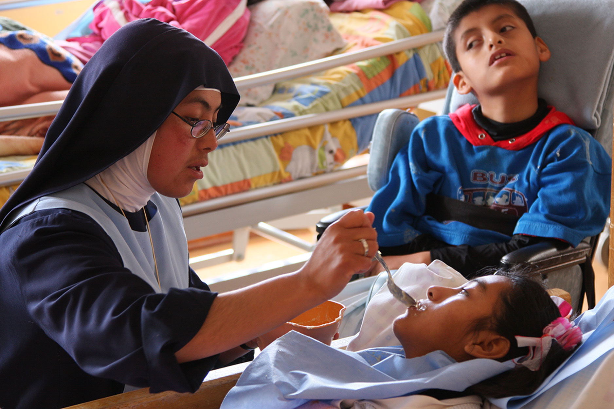
It is in communion,
even when this proves painful,
that a charism is seen to be authentic and mysteriously fruitful.” Evangelii Gaudium

Slide 5
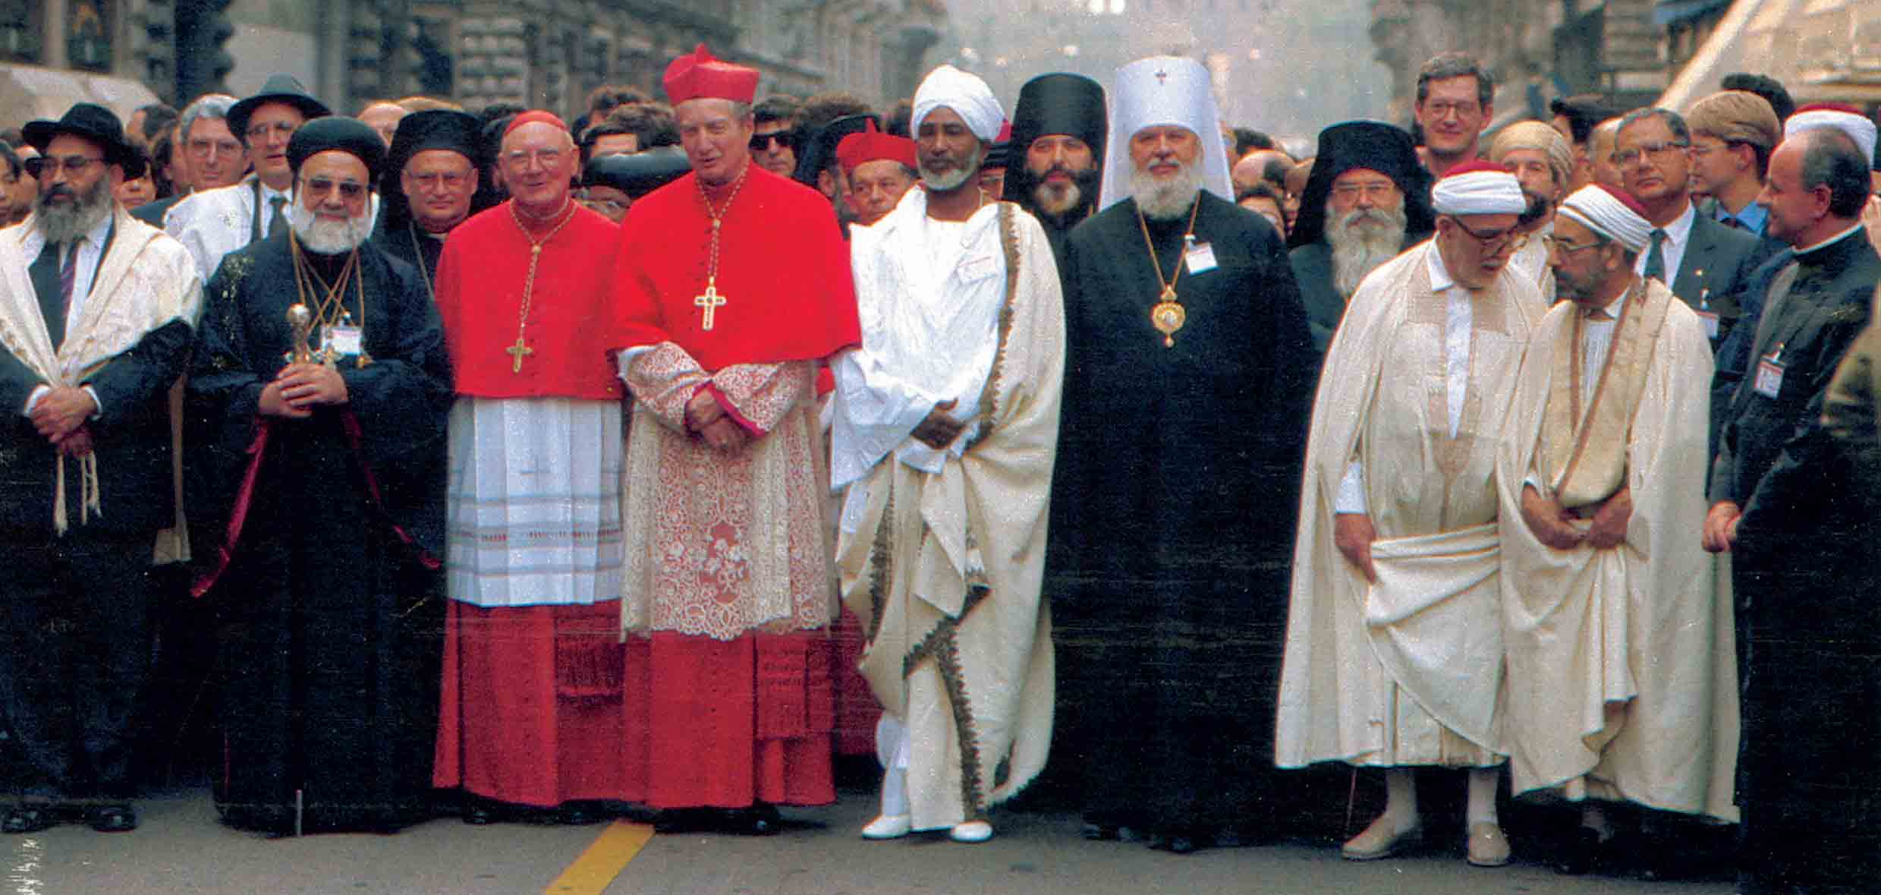
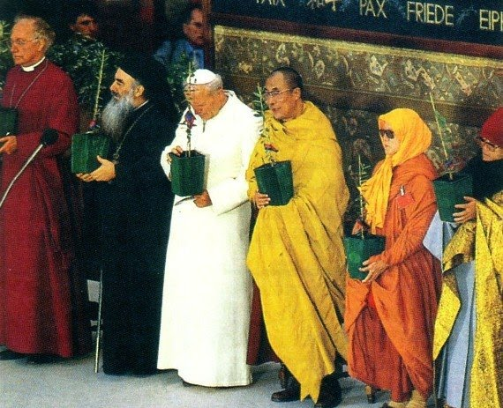
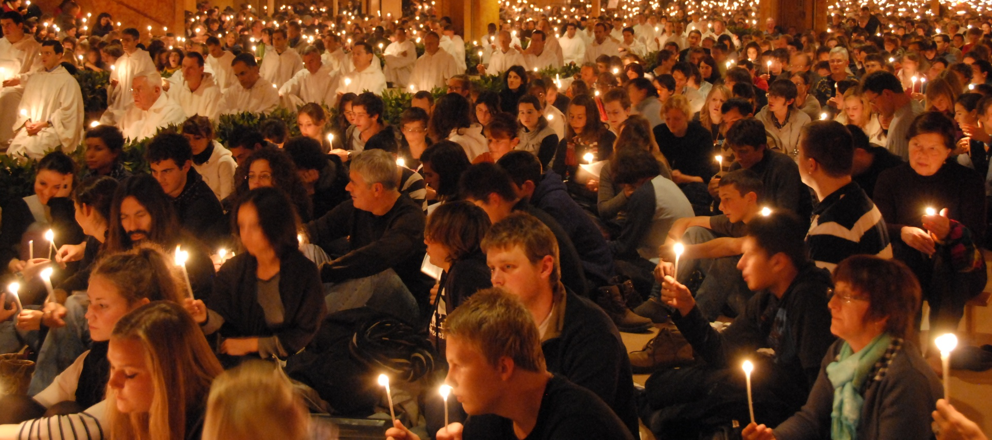
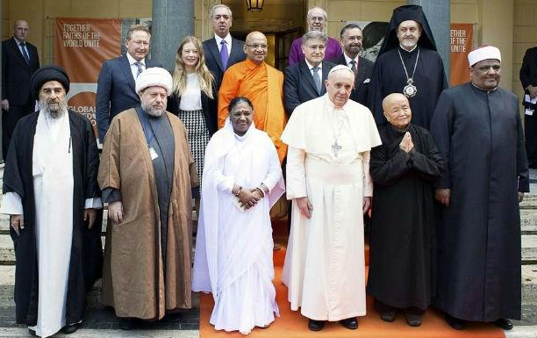
“Experts in communion”

Slide 6
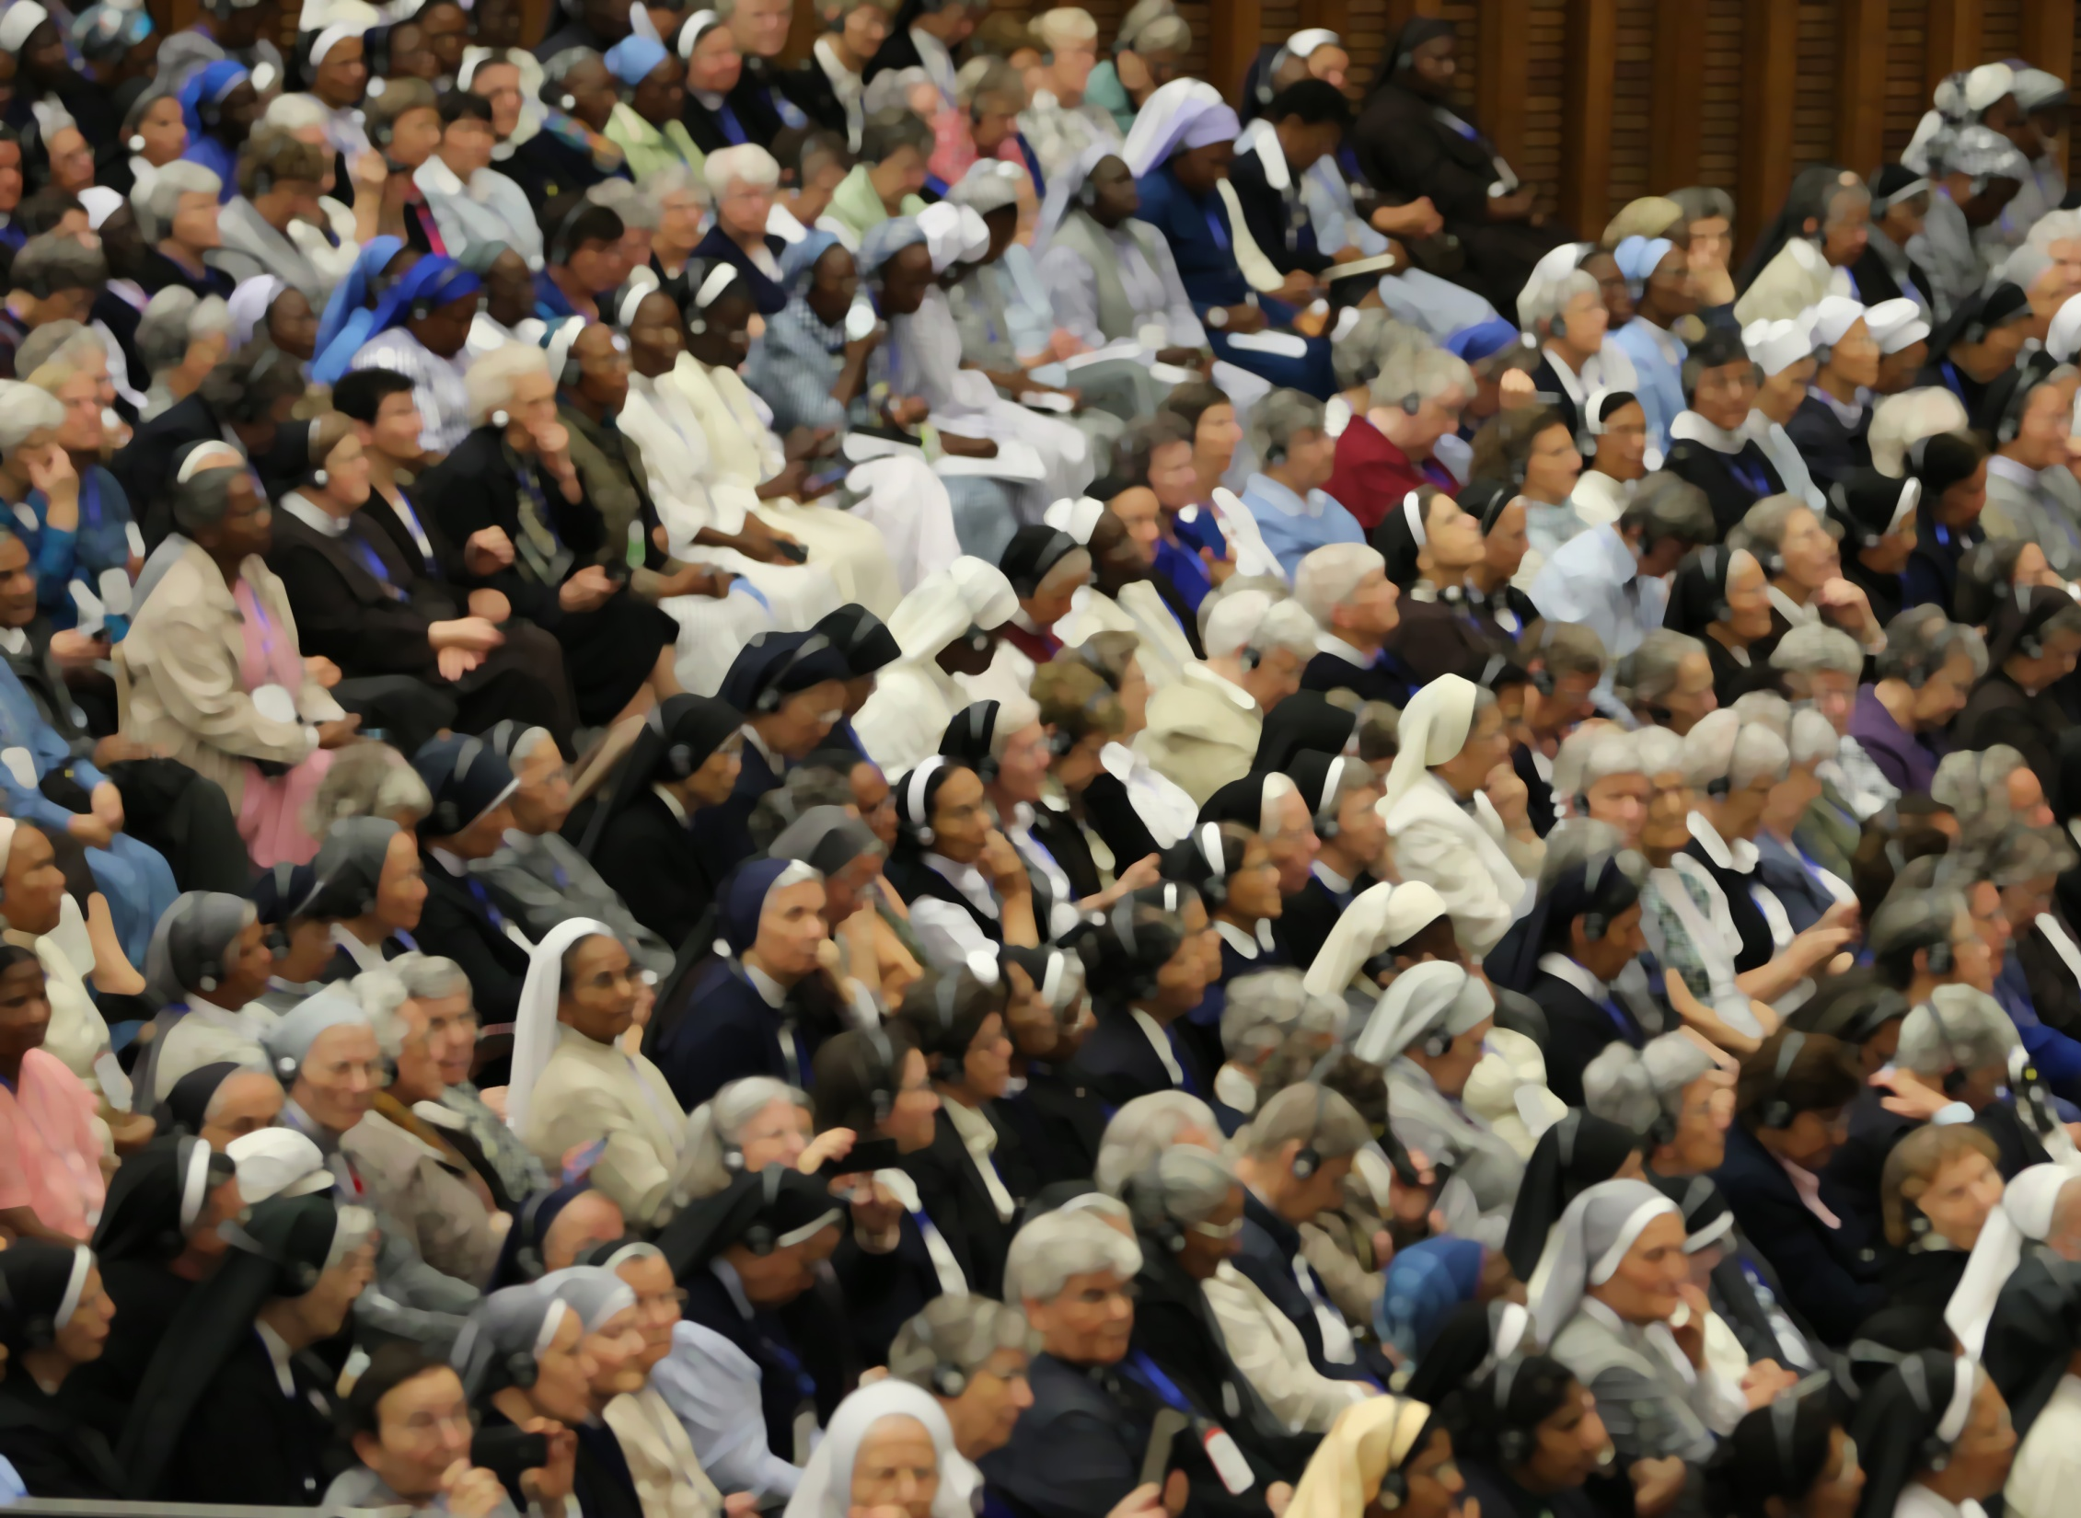
He emphasized that
“communion and encounter
between different institutes and different vocations
can open up a path to hope”

Slide 7
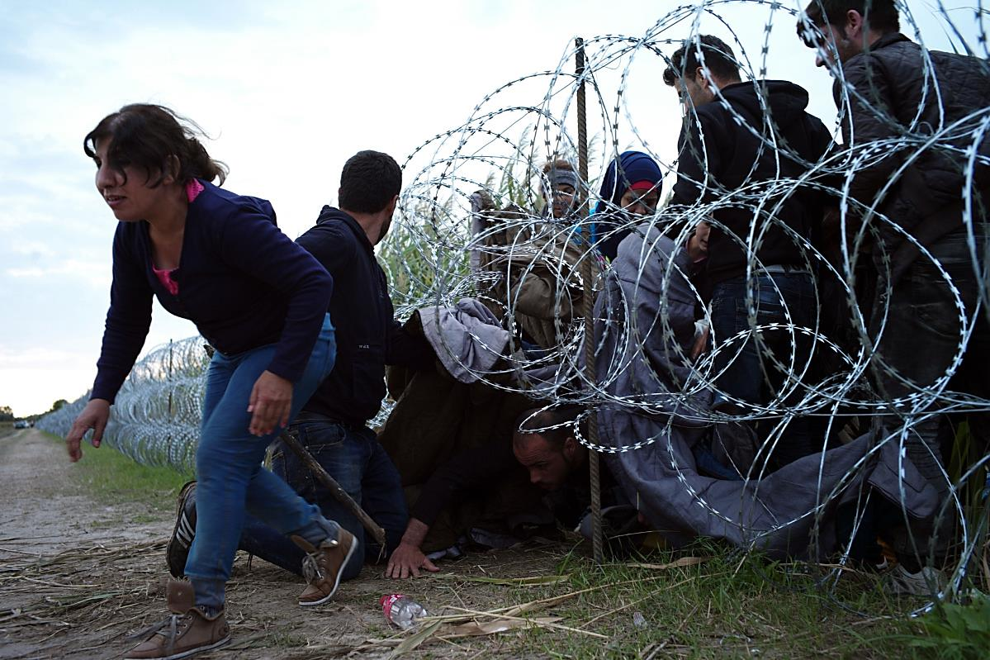
The borders, which separate people from one another. They are often visible borders
like the barbed wire fence constructed in Hungary

Slide 8
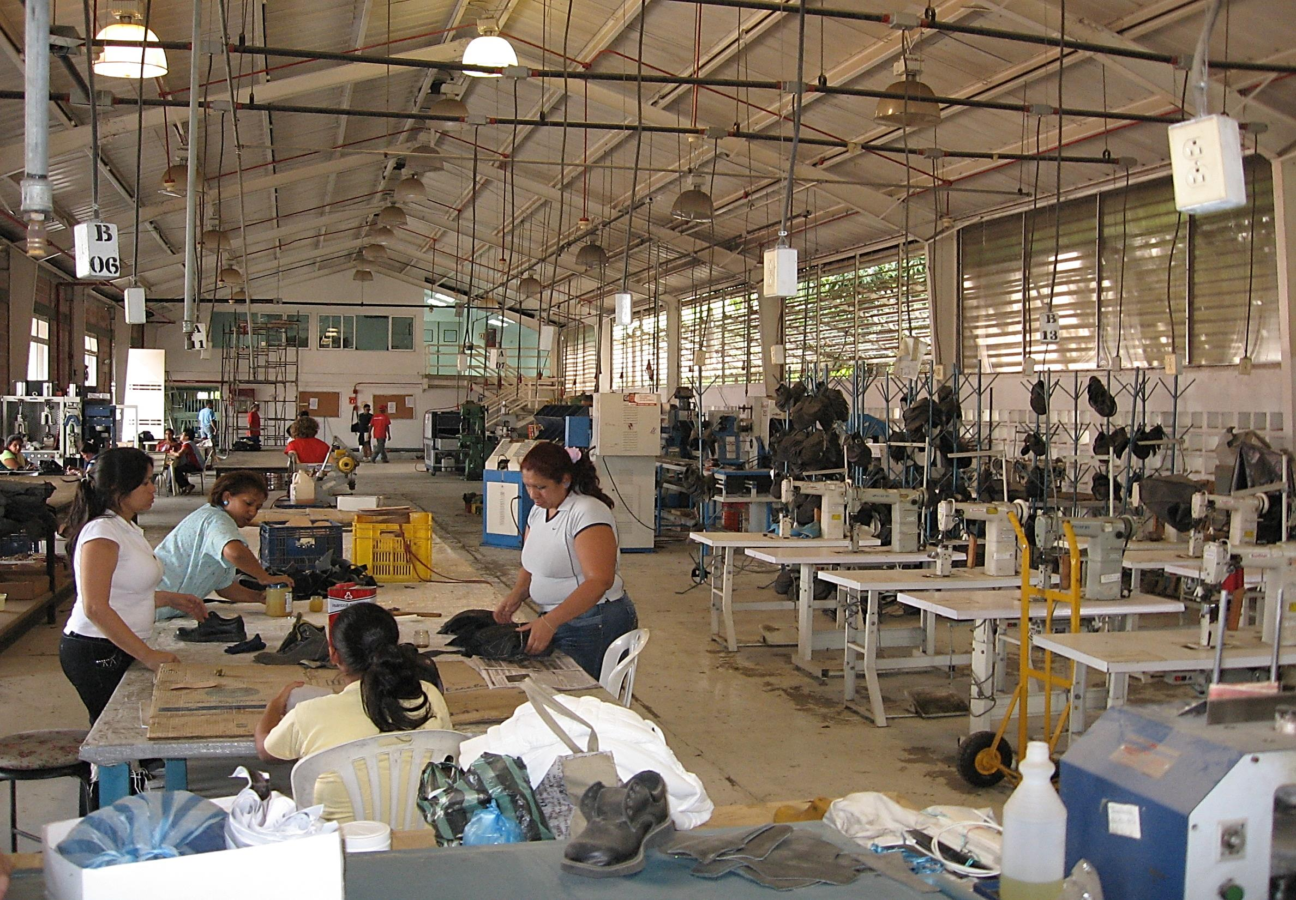
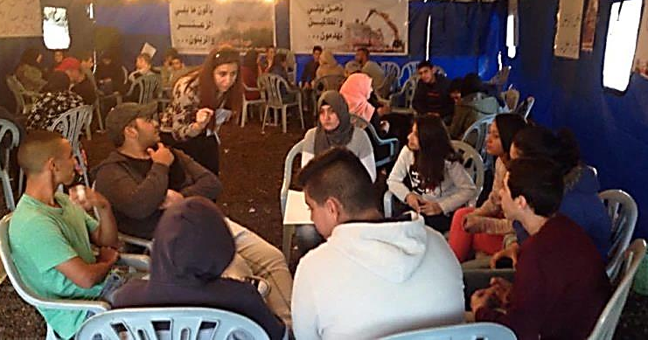
Places of resilience
and creativity, producing melting pots,
building solidarity
and creating
alternative ways of living…
where God is revealed
and love is proclaimed.”

Slide 9
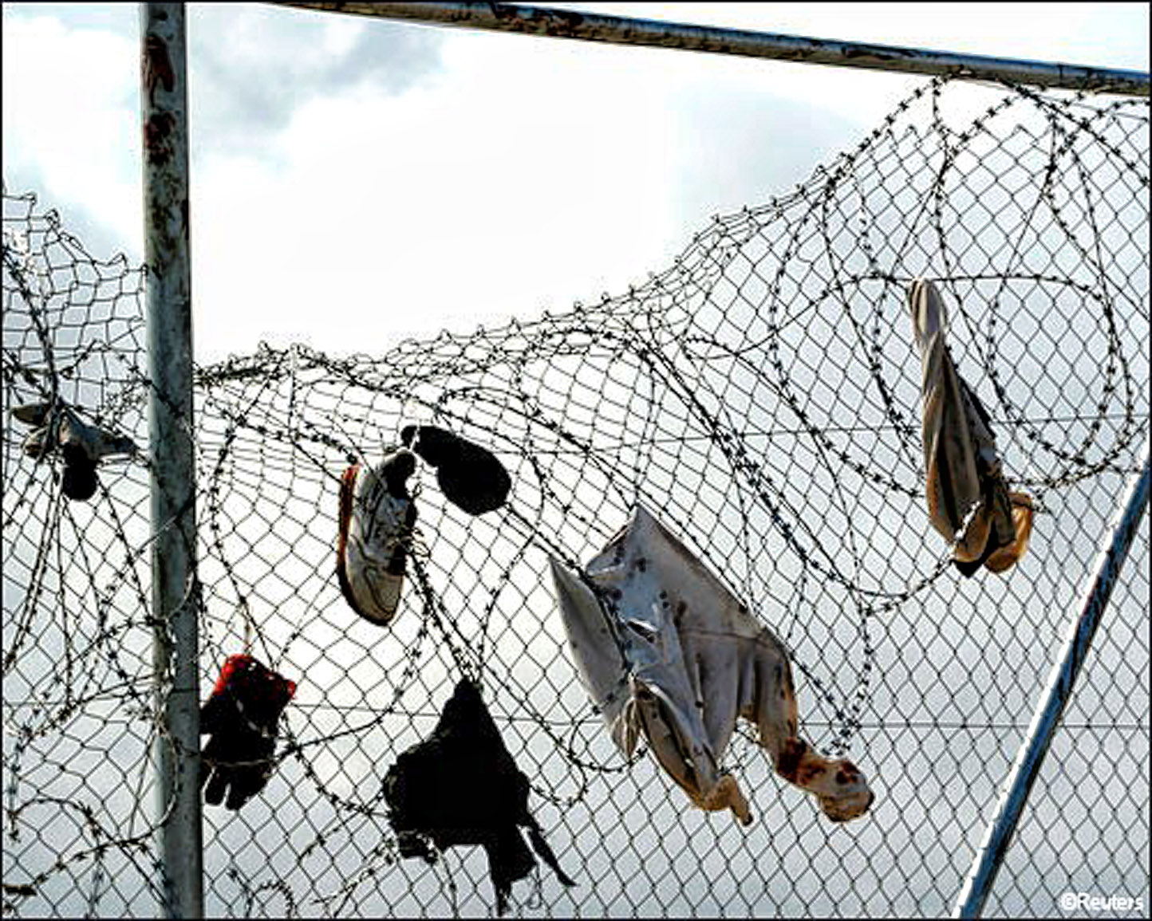
“To survive at the frontiers
one must live without frontiers
and be a crossroads”.

Slide 10
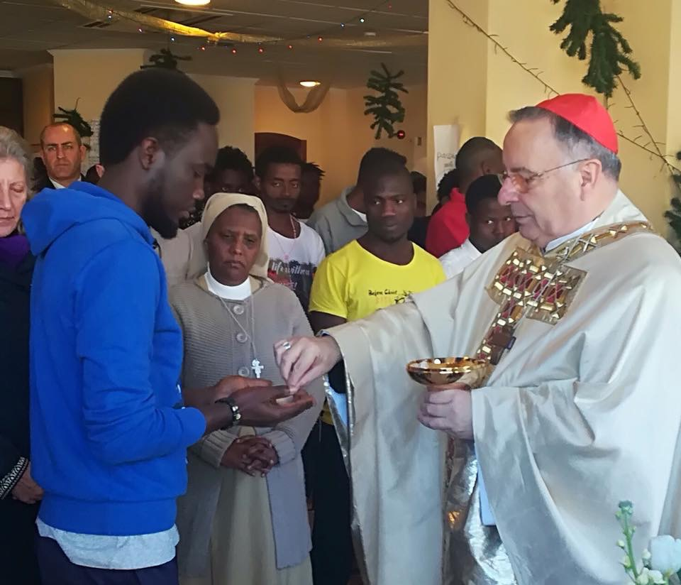
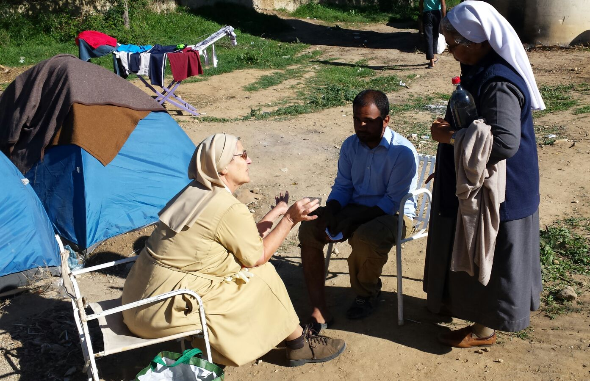
UISG prepared
10 sisters for ministry
among migrants
in Sicily
Sicilia
Notes:
CARMEN

Slide 11
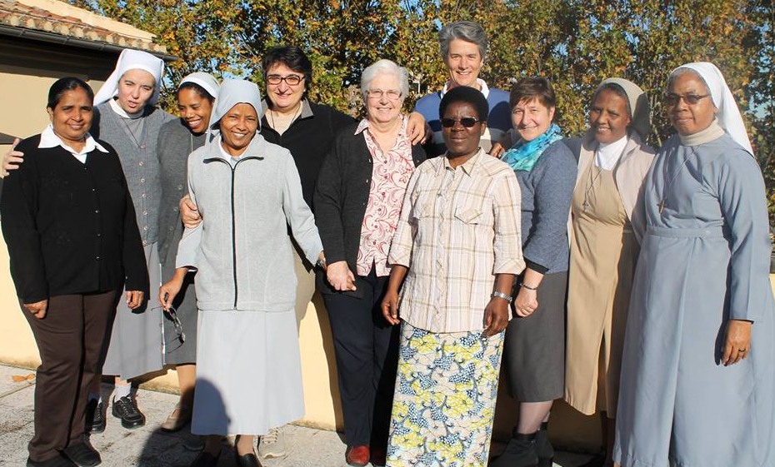
Different religious communities
and different nationalities
Notes:
CARMEN

Slide 12
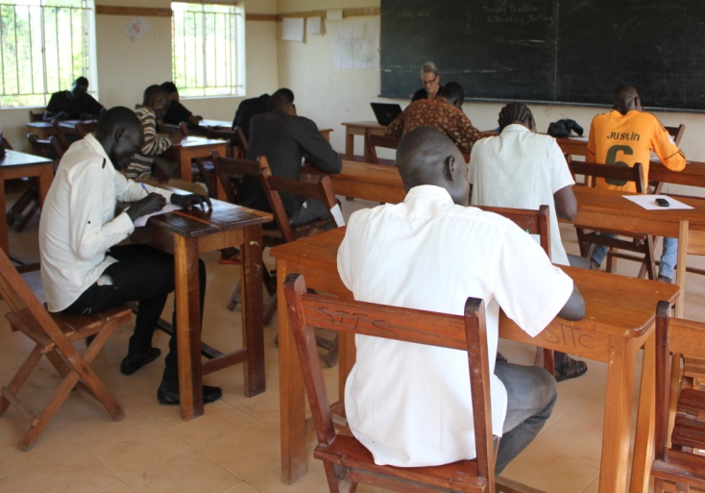
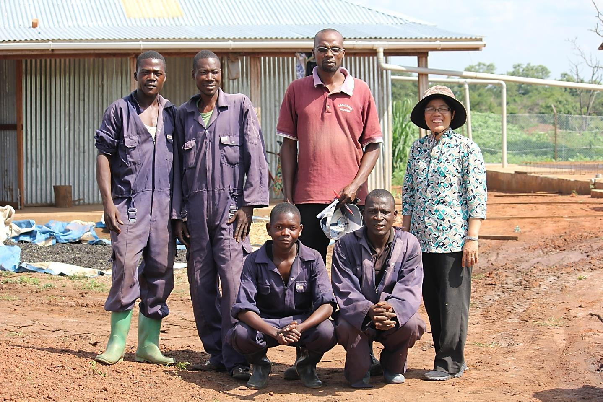
South Sudan

Slide 13
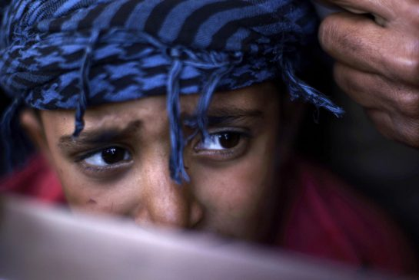
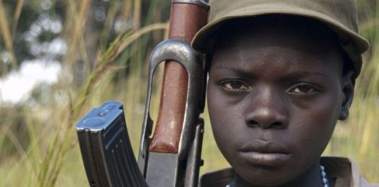
The faces of the people revealed trauma,
fear, bitterness,
grief and
desperation

Slide 14
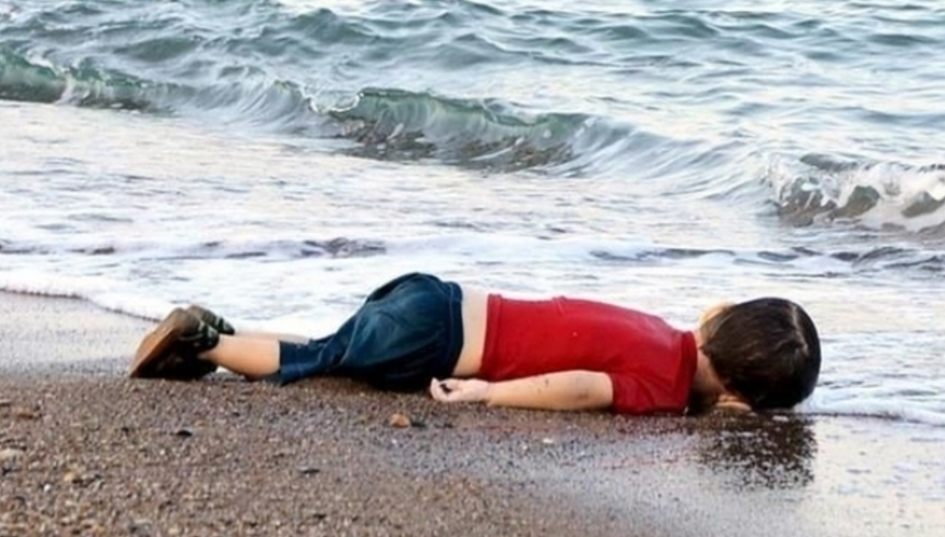
“a new paradigm… born
of compassion for the scarred and downtrodden
of the earth-around new priorities,
new models of organization
and open and flexible collaboration
between men and women of goodwill”.

Slide 15
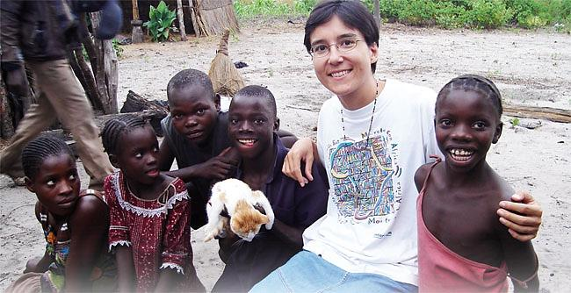
Democratic Republic of Congo

Slide 16
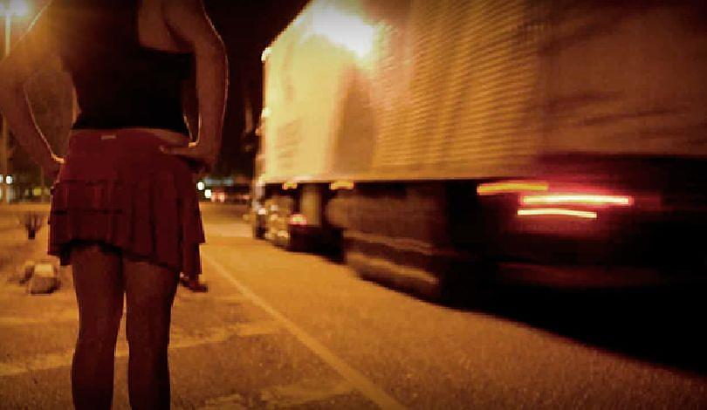
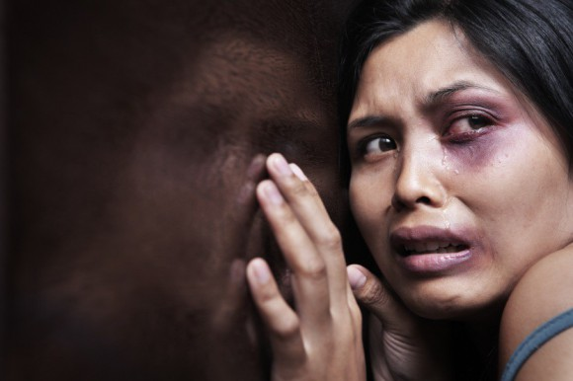
Human Trafficking

Slide 17
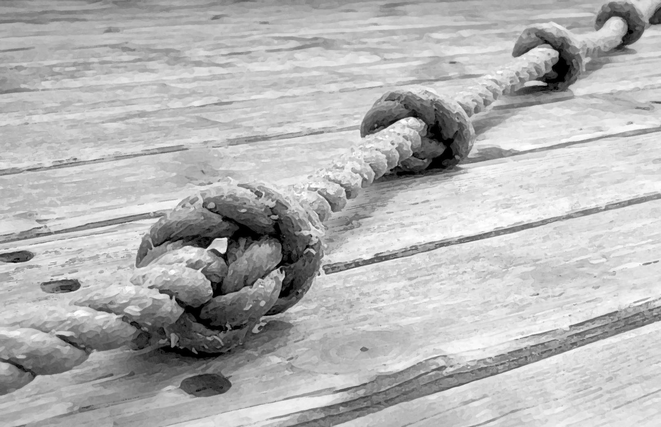
Talitha Kum
Pope Francis
“We must be more aware
of this new evil that,
in a global world, wants to hide it”
and that all men and women of good will arecalled
“to renew their commitment in improving
the human condition.”

Slide 18
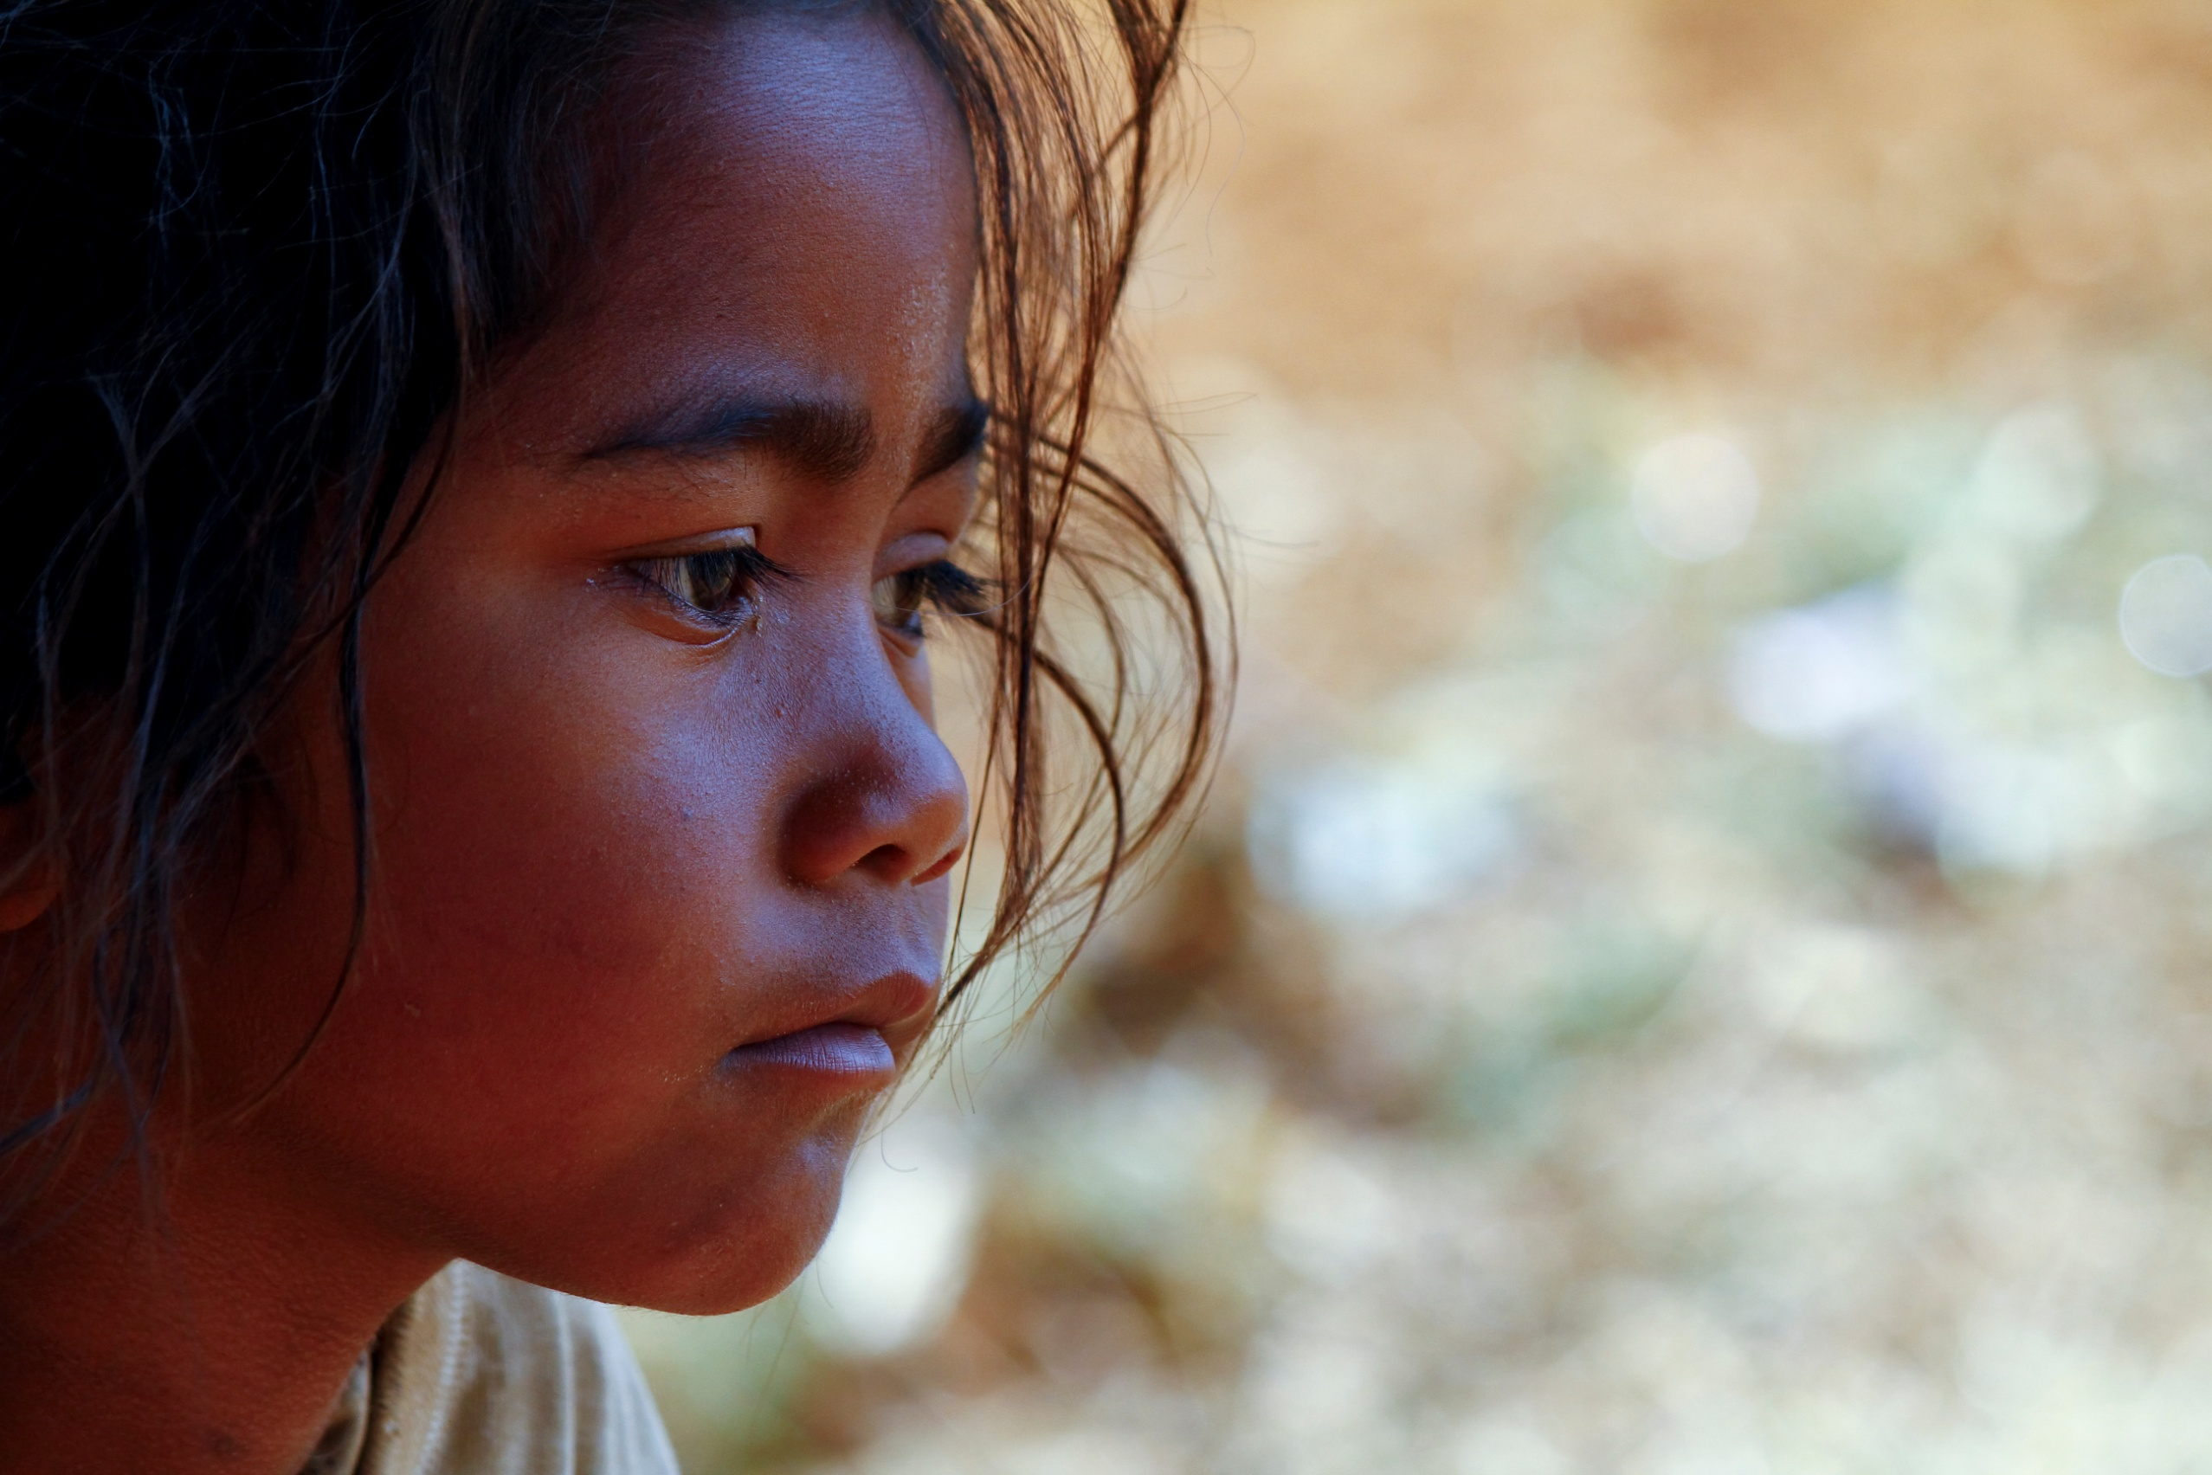
“plague
on the body
of contemporary
humanity”.

Slide 19
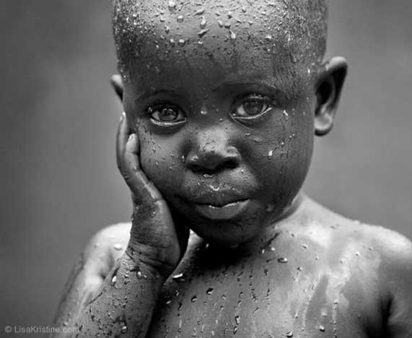
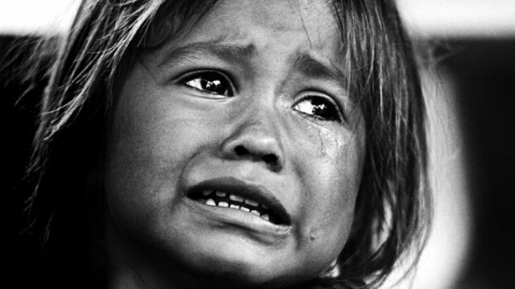
“presumes full respect for
the human person
but must also be concerned for the world around us.”

Slide 20
“Our generation will be remembered for having generously shouldered its grave responsibilities?"
Pope Francis

